Slide 1


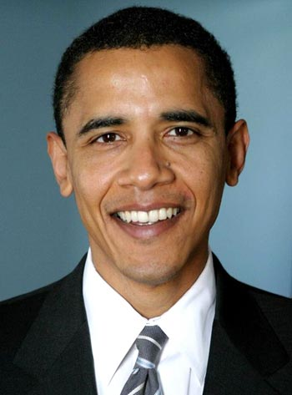
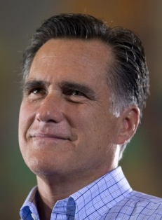
Two Party System
3

Slide 2
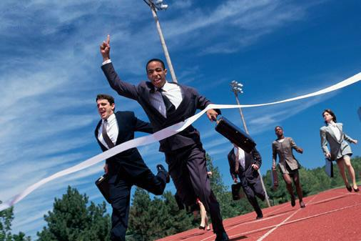
3rd Parties
NEW

Slide 3
3rd Parties
Introduce New Ideas
  Green Party:
    Protecting the environment
  Progressive party:
    8 hour working day
  Rent is too darn high party:
    Rent is to darn high
Sometimes revolve around a personality
  Teddy Roosevelt and the Bull Moose Party

Slide 4
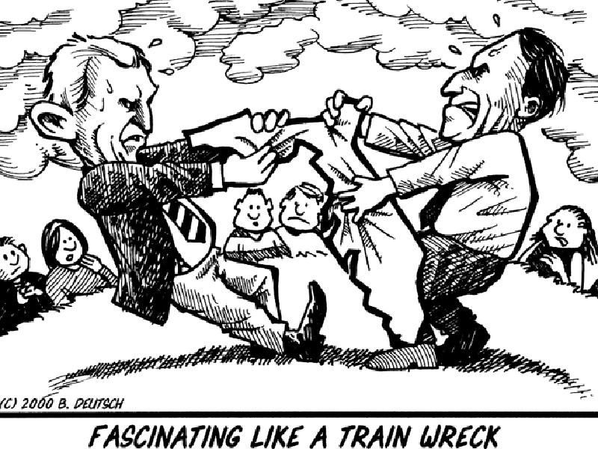
3rd Parties
Sometimes influence the outcome of an election

