Slide 1
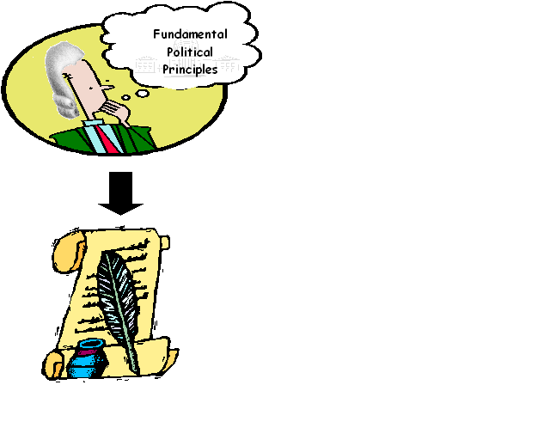

Significant Documents
US
Constitution

Slide 2


Fundamental Political Principles
Fundamental
  Basic
Political
  Government
Principle
  Idea

Slide 3
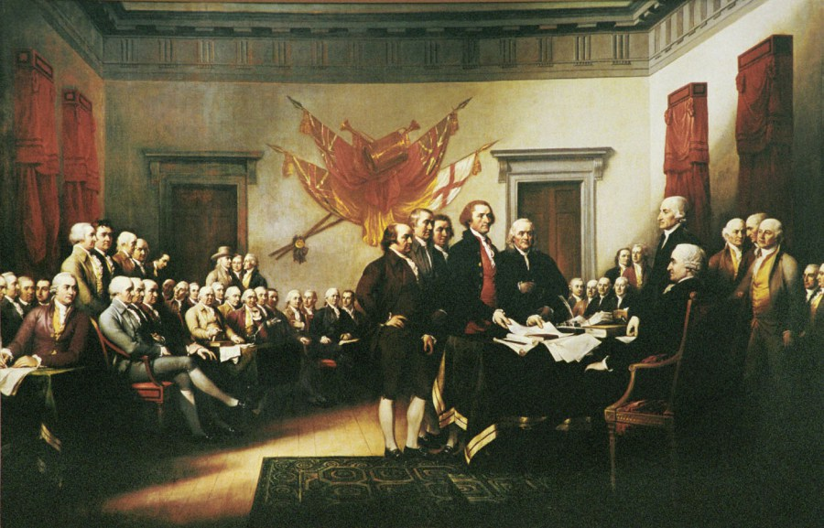
Let’s start a new gov’t?
Ok. What should it be like?
I’ve got some ideas.
Do tell Mr. Adams?

Slide 4
Not god, nor military power shall decide our leaders!
What is that?
Consent of the Governed
Power comes from the people!

Slide 5
…and the gov’t serves us. They protect us!
I am still confused.
Consent of the governed
We the people allow the gov’t to rule…
And if they don’t, WE pick a new gov’t!

Slide 6


Protect our rights
Preamble
Power
Power
Consent of the Governed
Power
Power

Slide 7
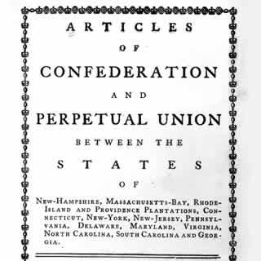




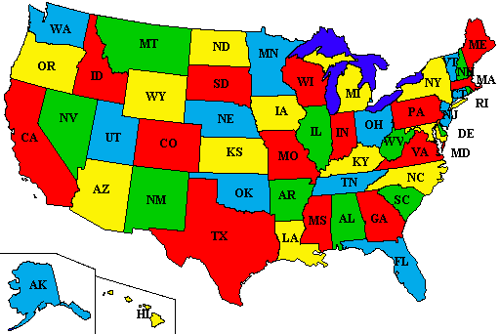


Preamble: intro that states the purpose of the US gov’t
We the people
To form a more perfect union
establish justice
domestic tranquility
common defense
promote the general welfare
blessings of liberty
Consent of the Governed
Kill Articles of Confederation
Fair courts & laws
Peace in USA
Protect from other countries
Make our lives better
Protect our rights

Slide 8
What if they have too much power?
We shall limit the government’s power!
Limited government
This gov’t sounds good.
Just like the King! They might abuse the people.

Slide 9
US Constitution

Slide 10
A Democracy!
The people will rule thru voting!
Democracy
Also, the people will make decisions by voting.

Slide 12
No one should be above the law.
It was unfair that British soldiers got away with murder in Boston!
Rule of Law
Everyone must be treated equally by the gov’t.
Let’s call it “the rule of law.”

Slide 13
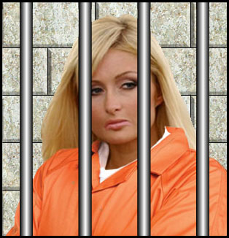
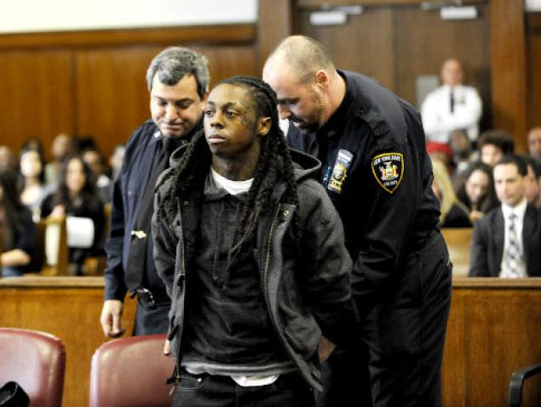
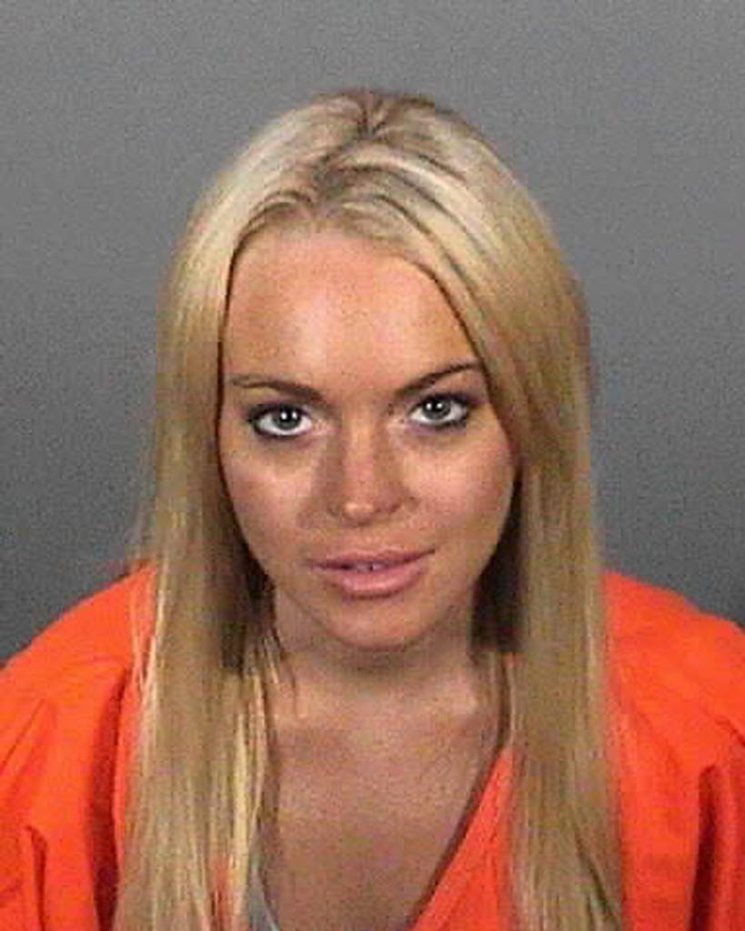
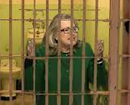
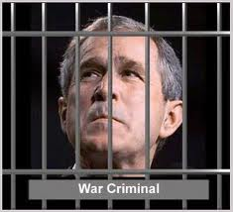
Rule of Law

Slide 14
Representatives?
The citizens will vote for people to vote for them!
Representative
Gov’t
But, the citizens cannot vote on everything!

Slide 15


Slide 16
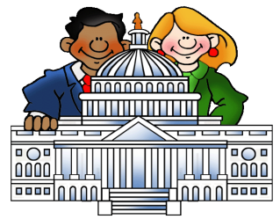

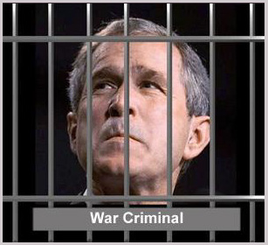
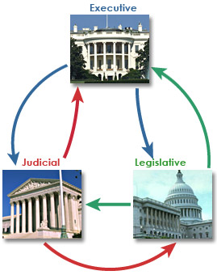


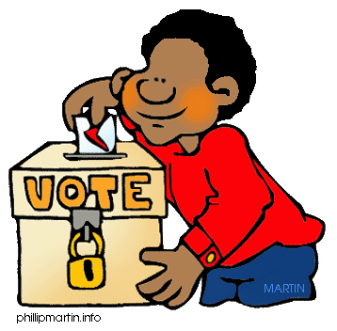
Fundamental Political Principles
Consent of the Governed
Representative
Government
Limited Government
Rule of Law
We pick people to vote for us
People are
The source of power
Democracy
Gov’t cannot do anything it wants
No one is above the law
People rule thru voting

Slide 17
FPP - Restaurant
Starting a government?
  How is your government going to work?
  What is it about?
    You need ideas
    Fundamental Political Principles
Starting a Restaurant?
  How is your Restaurant going to work?
  What is it about?
    You need ideas
    Fundamental Political Restaurant Principles

Slide 18
5 ideas
Gov’t
5 ideas
restaurant

Slide 19
FPP - Restaurant
1. On a piece of paper
  Write 5 ideas for your restaurant
2. On a PowerPoint slide
  Make an advertisement flyer
    Mention your ideas
    Use pictures
Everything start with ideas

