Slide 1
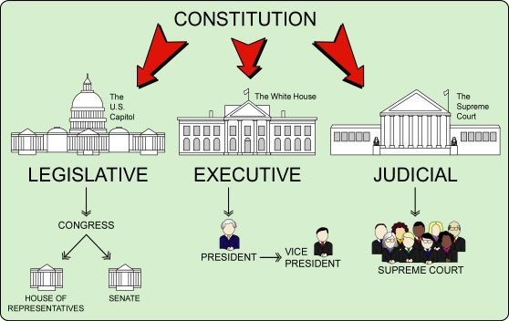

Slide 2





Criminal Law

Slide 3
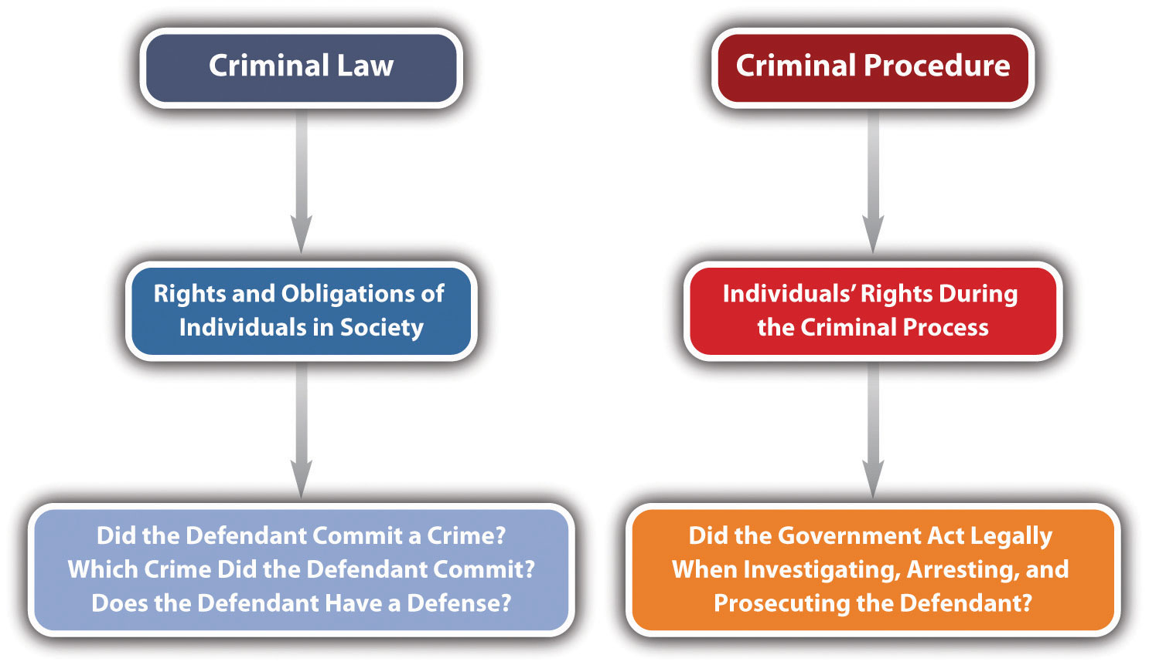
Criminal Law and Procedure

Slide 4
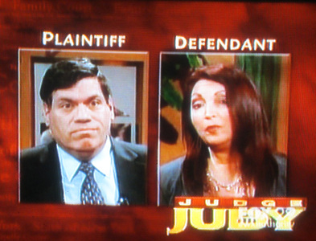
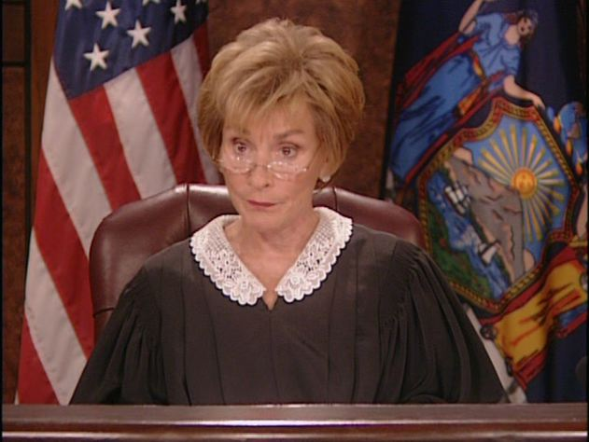



Civil Law

Slide 5
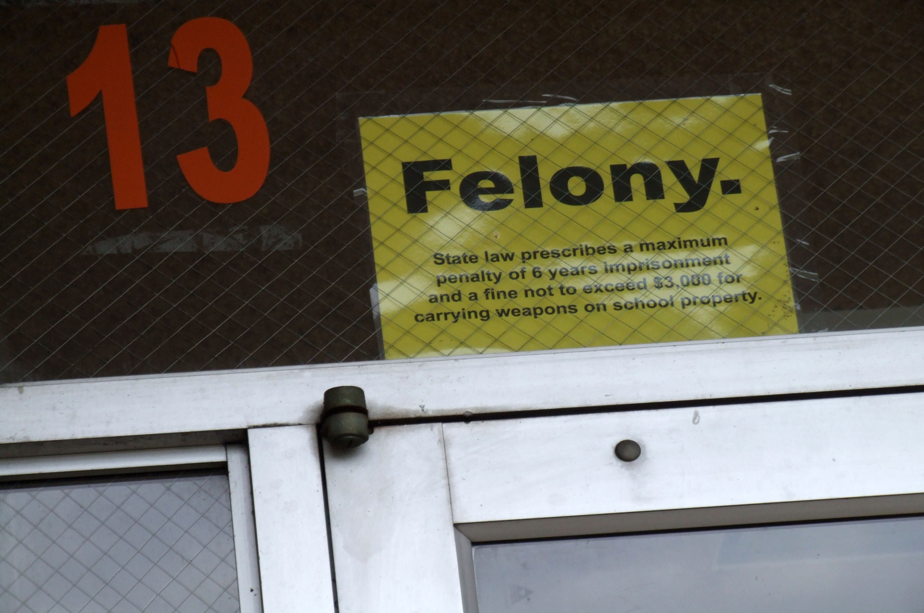
Felony

Slide 6
Felonies in Virginia
A felony is a criminal offense with maximum penalties greater than one year in prison. Felonies include:
murder
malicious wounding
armed robbery
burglary (unarmed, Class 3 felony, armed is a Class 2 Felony)
grand larceny
possession of drugs
domestic assault (3rd offense or greater)
malicious wounding
threatening to kill or do bodily harm
use of a firearm in commission of a felony
child endangerment and other serious charges.

Slide 7

Misdemeanor

Slide 8
Misdemeanors in Virginia
A misdemeanor is an offense that can have a penalty of up to one year in jail. Under Virginia law, misdemeanors are divided into four classes (I, II, III, and IV). Some typical Class I misdemeanors include:
possession of marijuana
petty larceny (shoplifting)
assault and battery
stalking
computer fraud
DUI (DWI) aka Drunk Driving
disorderly conduct
domestic assault
reckless driving
oral threat of harm
violation of a protective order
and more…

Slide 9

Civil Law Procedure
file complaint

Slide 10
Civil Law Procedure
trial
JURY

Slide 11

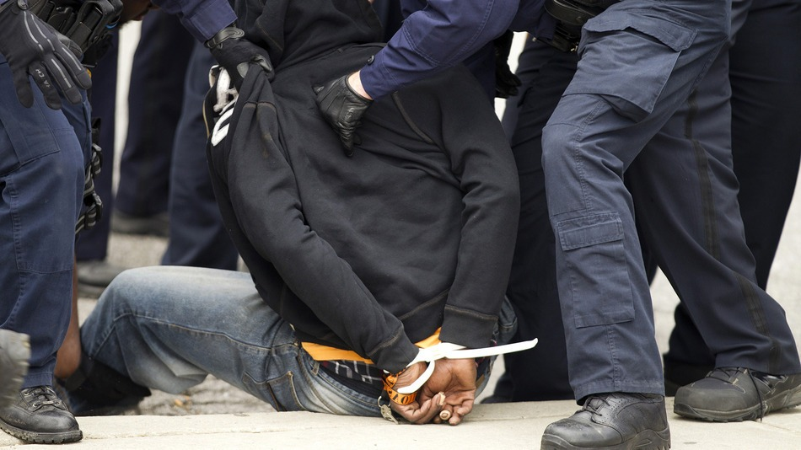
Criminal Law Procedure
Arrest

Slide 12
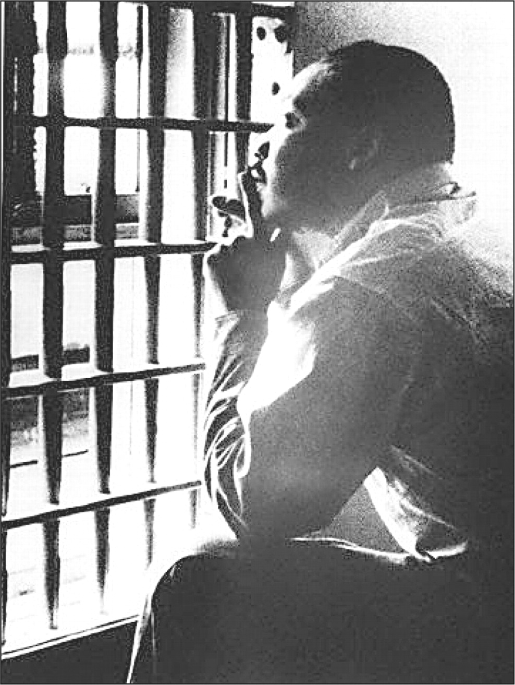
Criminal Law Procedure
Jail awaiting bail

Slide 13
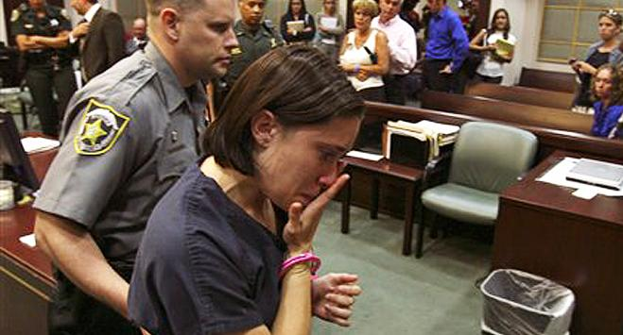
Criminal Law Procedure
Arraignment
-plea
Not Guilty.

Slide 14
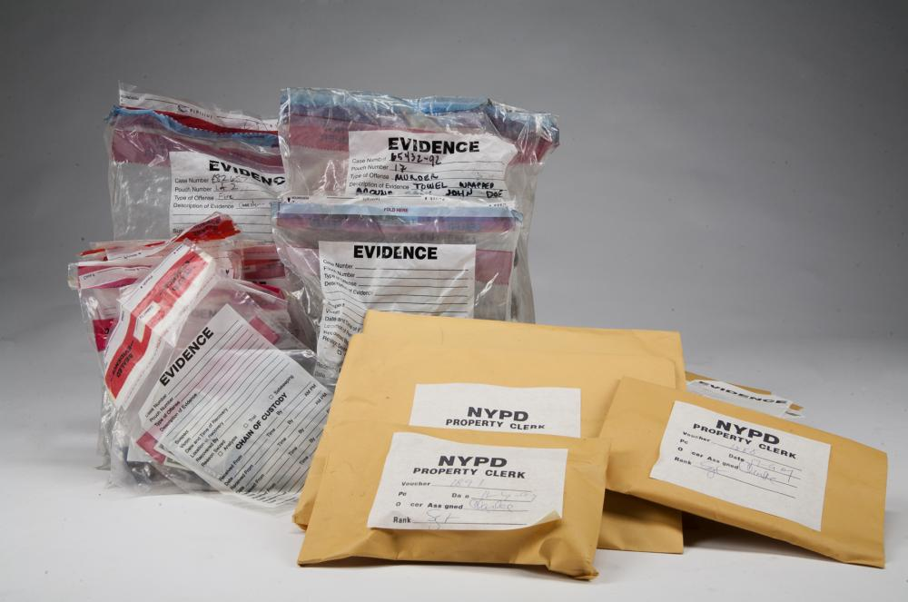
Criminal Law Procedure
Arraignment
-probable cause is reviewed

Slide 15

Criminal Law Procedure
Arraignment
-attorney if needed

Slide 16

Criminal Law Procedure
Arraignment
-trial date is set

Slide 17
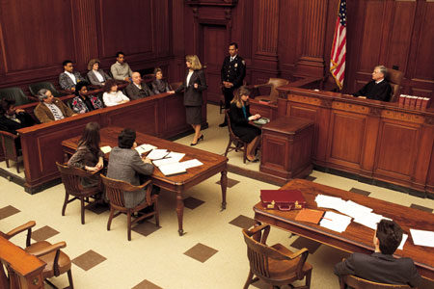
Criminal Law Procedure
Trial

Slide 18
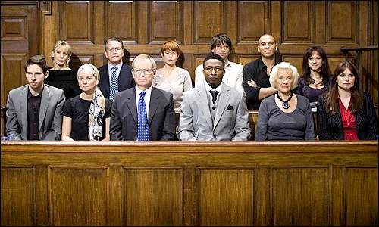
Criminal Law Procedure
Verdict
Guilty!

Slide 19
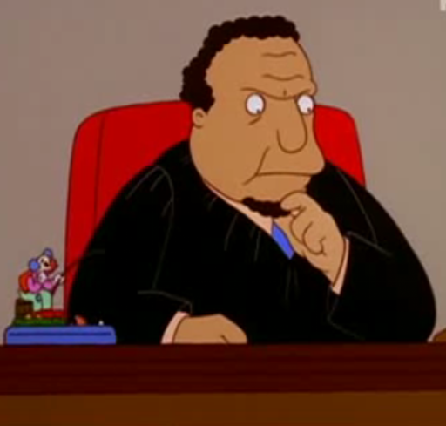
Criminal Law Procedure
Sentencing
200 hours of community service.

Slide 20
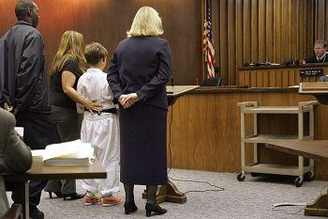
Juvenile Court Procedure

