Slide 1
Create Your Own Government Activity

Slide 2
Class Assignment

Slide 3
Project

Slide 4
Presentations
Part 2: Presentations
You will be presenting your country’s project to the class. Make sure that everyone in the group takes part in the presentation. The class will be filling out a worksheet based on your presentation so be sure that you present all the information in your brochure.

Slide 5
Create a slide and define each of the following terms
Oligarchy
Absolute Monarchy
Totalitarian (a type of dictatorship)
Direct Democracy
Representative Democracy
Dictatorship
Theocracy
Constitutional Monarchy

Slide 6
Team/Peer Assessment

Slide 7
What are the Different Types of Government?
No two governments are alike.
They are shaped by their country’s unique history, culture, politics, and economy.
2 Broad Categories of Government:
  Authoritarian-
  Democratic-

Slide 8
2 Broad Categories of Government
Authoritarian
One ruler or a small group of leaders
citizens do not have any voice in how they are ruled
Democratic
government that gives power to the people
are based on "rule of law.“
Have free and fair elections

Slide 9
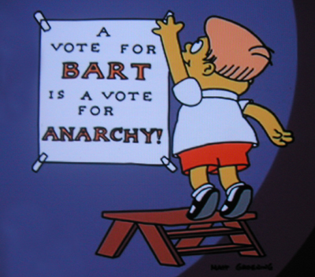
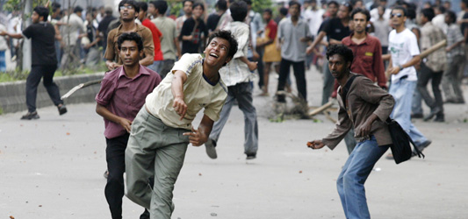
Anarchy
No govt.
No laws

Slide 10
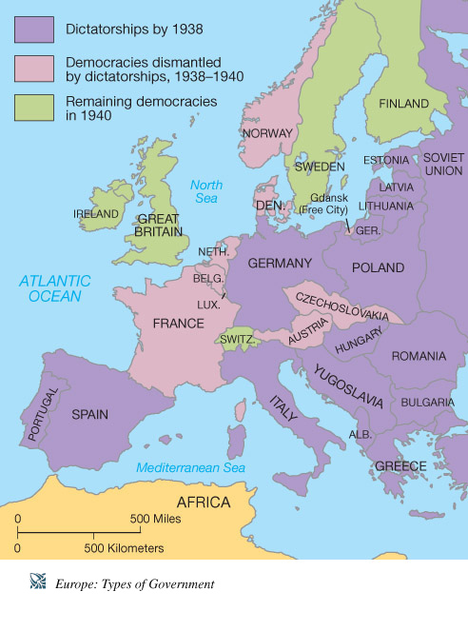
Types of Authoritarian Govts.
  All have:
  One person or small group run govt.
  Leader(s) not accountable to the people

Slide 11
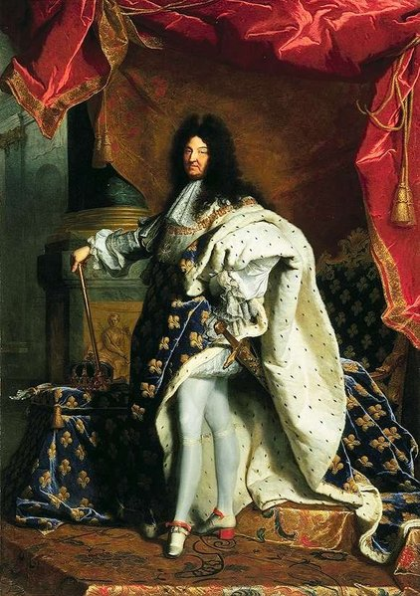
Monarchy
Govt. ruled by king or queen
King Louis the 14th of England

Slide 12
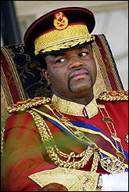
Absolute Monarch
Ruler inherits power through family & has unlimited authority
Failure to investigate and prosecute those responsible for torture and deaths in custody and abusive policing involving the use of excessive force
Denial of the rights of freedom of association and peaceful assembly to those perceived as government critics
Undermining of the role of courts in protecting the rights of women and girls against forced marriages, including by members of the Royal Family
Failure to protect women and girls against rape and other forms of sexual violence which has contributed to Swaziland having the highest HIV prevalence in the world
Politically-motivated forced evictions without the right to effective legal redress, resulting in violation of the victims' rights to livelihood, shelter, education and health.
King Mswati of Swaziland is an absolute monarch

Slide 13
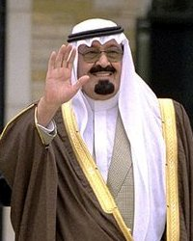
Saudi Arabia’s Absolute Monarch
Crown Prince Abdullah
Bending under strong international pressure, Crown Prince Abdullah and his family, who have absolute power, are holding municipal elections – the people living in cities and towns get to elect city leaders
Women may not vote or run for office, owing to “technical difficulties”: Most Saudi women don’t have the photo IDs needed to register; there aren’t enough female officials to register those who do; and men may not register women, because the sexes are forbidden to mingle in public.
Worldwide, the royal family promotes an extreme form of Islam called Wahhabism, which considers all followers of other religions—even other Muslims—“infidels.”
In 2004, the U.S. State Department added Saudi Arabia to its list of nations in which religious liberty is severely violated.

Slide 14
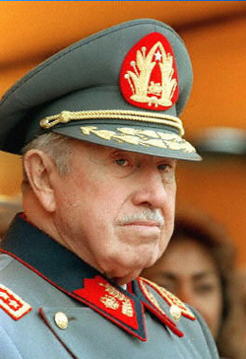
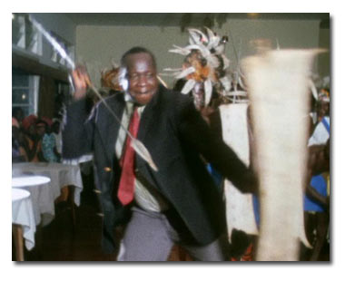
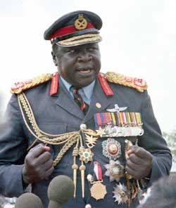
Types of Auth. Govts., Cont’d.
Dictatorship – Rule by one person (or small group of people) who have complete control over the nation and its people
Augusto Pinochet, former dictator of Chile

Slide 15
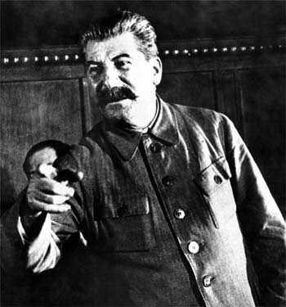
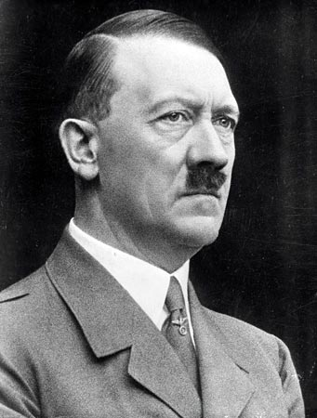
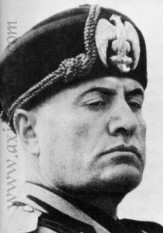
Totalitarian Govt.’s
Govt. regulates nearly every aspect of public and private life of citizens
Under Stalin’s rule – 60 million “dissidents” sent to their deaths
Hitler – 6 million Jews – many millions more dead in combat
Mussolini, fascist dictator of Italy during WWII

Slide 16
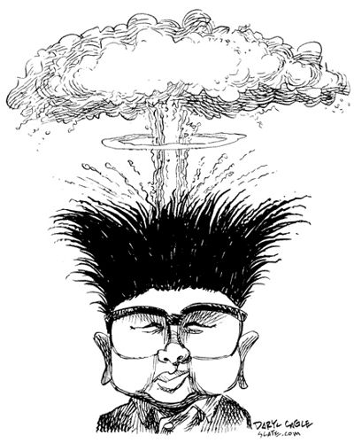
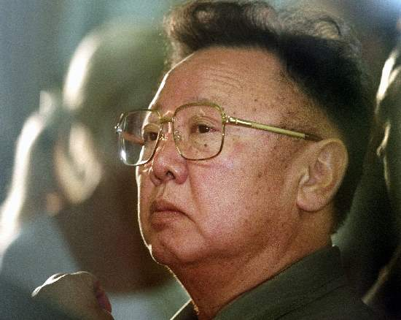
Totalitarian Govts. Cont’d.
North Korea: Present-day totalitarian regime

Slide 17
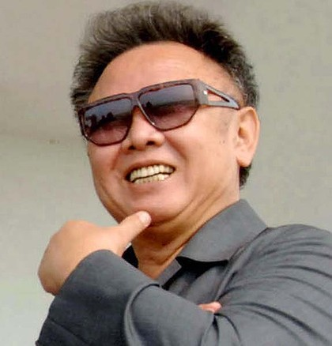
Kim Jung Il North Korea
The Ministry of People’s Security places spies in workplaces and neighborhoods to inform on anyone who criticizes the regime, even at home.
All radios and TV sets are fixed to receive only government stations.
Disloyalty to Kim Jong Il and his late father, Kim Il Sung, is a punishable crime: Offenses include allowing pictures of either leader to gather dust or be torn or folded.
The population is divided into “loyalty groups.” One-third belong to the “hostile class.” These people receive the worst jobs and housing and may not live in the capital, Pyongyang.
Below the hostiles are the estimated 250,000 held in prison camps, some for crimes allegedly committed by relatives. Executions often are performed in public.

Slide 18
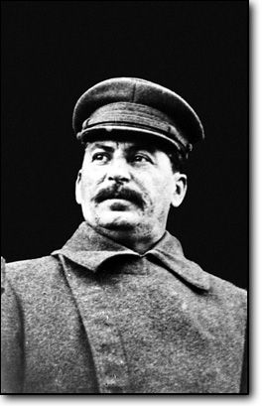
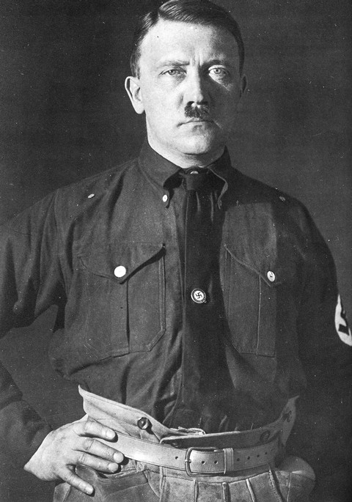
Dictatorship
Govt. controlled by one person or small group of people

Slide 19
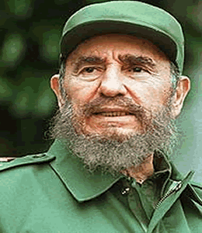
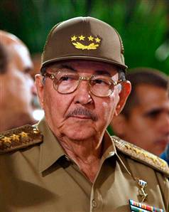
Fidel Castro of Cuba
Modern-day dictator
Fidel Castro, dictator of Cuba
Raul Castro, Fidel’s brother

Slide 20
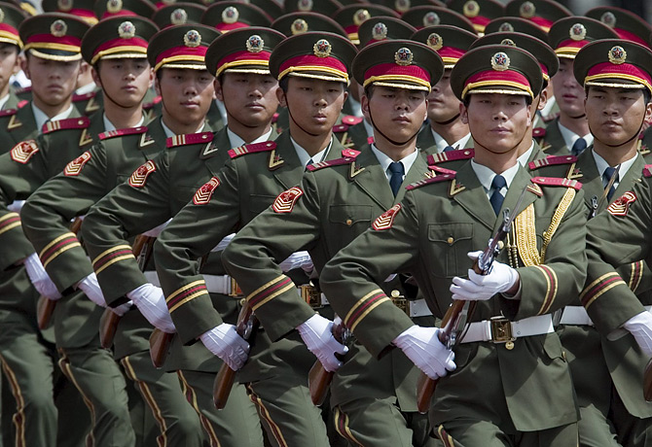
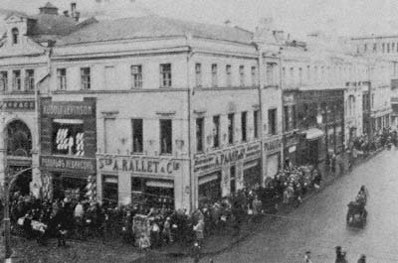
Communist Govt.’s
China, Cuba
Central govt. makes all economic decisions.
People do not decide who will govern them.

Slide 21
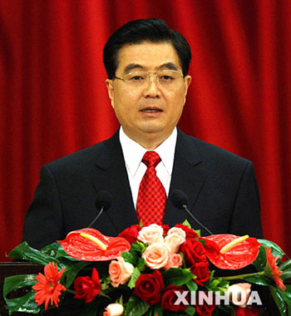
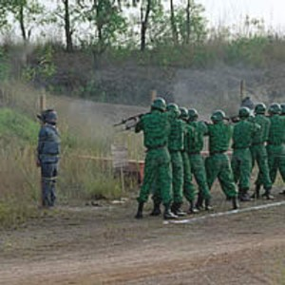
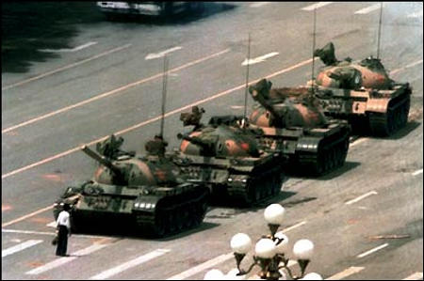
China
Some 250,000 Chinese are serving sentences in “re-education and labor camps.”
China executes more people than all other nations combined, often for nonviolent crimes.
The death penalty can be given for burglary, embezzlement, counterfeiting, bribery or killing a panda.
Hu’s government controls all media and Internet use. Defense lawyers who argue too vigorously for clients’ rights may be disbarred or imprisoned.
If minorities (such as Tibetans) speak out for autonomy, they’re labeled “terrorists,” imprisoned and tortured.
CPC Chairman Hu Jintao

Slide 22
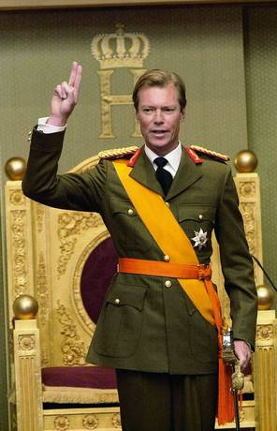
Constitutional Monarchy
A.K.A. Limited Monarchy
Power of the monarch is limited by a constitution and laws.
Luxembourg, a Constitutional Monarchy under a system of Parliamentary Democracy

Slide 23
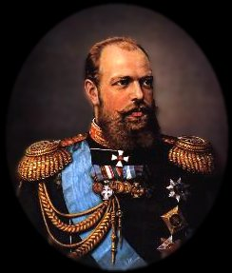
Autocracy
One person holds unlimited power in the govt.
Alexander III , Russian Tzar 1881 to 1894
2 Types:
  Monarchical autocracy
    Traditional absolute monarchies with a hereditary crown.
  Republican autocracy
    Single absolute leader who is not a monarch and does not belong to a hereditary dynasty
    Usually military dictatorships or one-party states (but not all military dictatorships and one-party states are autocratic; some are oligarchies).

Slide 24
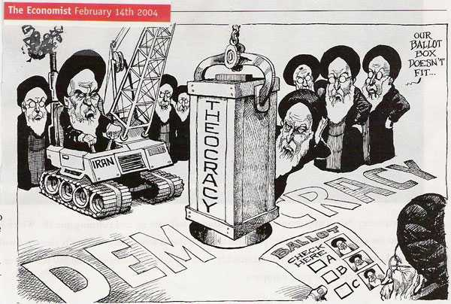
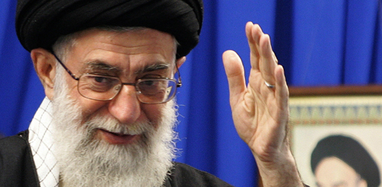
Theocracy
Govt. where religion or faith plays a dominant role in govt.
Grand Ayatollah Ali Khamenei
Iranian Religious Laws

Slide 25
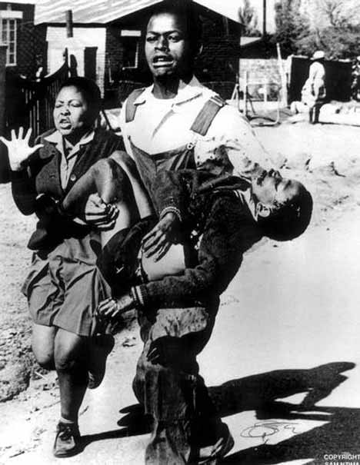
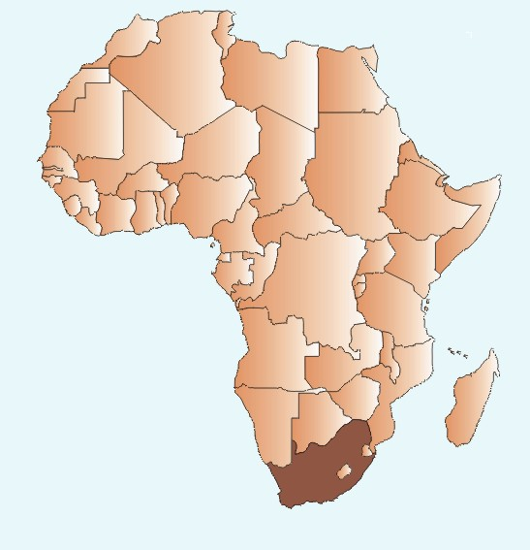
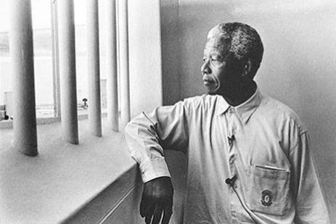
Oligarchy
Most political power rests with a small segment of society
  Usually those w/ most wealth, military strength, political influence, a certain race, etc.
Until the end of apartheid, South Africa was an oligarchy – the white Afrikaners (20% of the population) were the only citizens who could vote. In effect, they controlled the other 80% of (non-white) South Africans

Slide 26
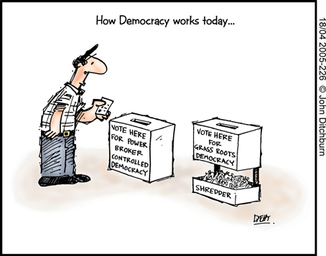
Democratic Govt.’s
Ruled by the people, not a single leader

Slide 27
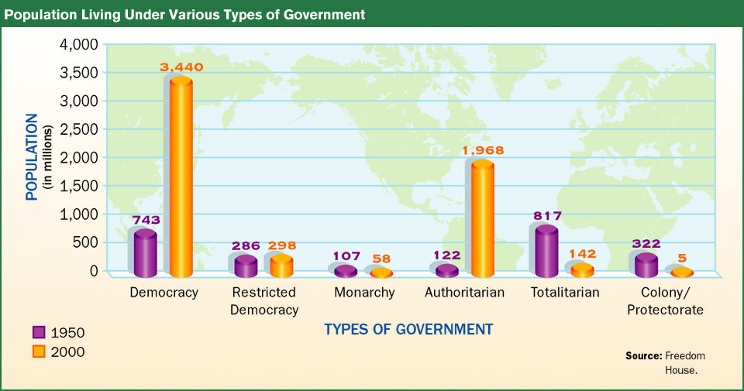
About 2/3 of all countries in the world have democratic govt.’s

Slide 28
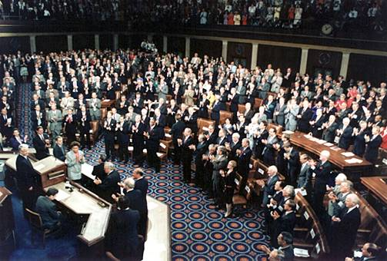
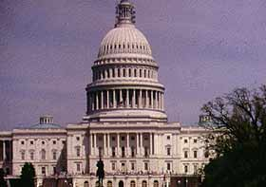
What is a Representative Democracy?
Voters choose a smaller group to represent them
  They write & pass laws on behalf of the people
Source of govt. power = the people
Majority Rule:
  Govt. will do what the MOST of the people want it to do

Slide 29
Basics of American Democracy
Rule of Law
  All citizens must obey the laws (even the president)
Limited Govt.
  The govt. can only do what the people say it can do
Individual Rights
  Rights the govt. cannot take from any person

Slide 30
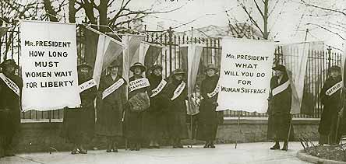
American Democracy Basics, Cont’d.
Consent of the governed
  Citizens allow govt. to govern them
Representative Govt.
  People elect govt. officials to make laws & govern on their behalf

