Slide 1

Legislative
Executive
Congress
- Senate
- House of representatives
President
- Vice President
- Cabinet
National
General Assembly
- Senate
- House of delegates
Governor
- Lt. Governor
- Cabinet
State
Manager
- hired
county
Board of Supervisors
Local
city/town
Council
Mayor

Slide 2
Virginia
Courts
Va Supreme Court
-appeals
-limited-original
Justices
Va Court of Appeals
-appeals
Judges
Circuit
-felonies
-civil case (hi $)
-appeals
Judge
& Jury
General District
Juvenile &
Dom. Relations
-misdemeanors
-civil case (lo $)
Judge
Judge

Slide 3
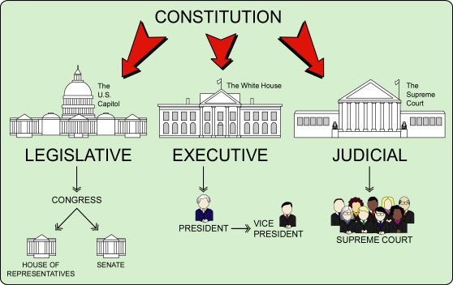


Branches of Gov’t
Legislative
  Make laws
Executive
  Enforce laws
Judicial
  Interpret laws
General Assembly
Governor
Lt.
Governor
of Virginia
Delegates
Delegates

Slide 4
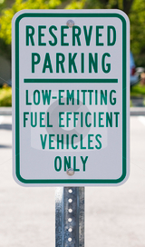
Types of Powers
Enumerated
Implied
Concurrent
Reserved

Slide 5

State Legislative Branch
Make Laws
Approve budget
Bienniel : Every 2 years

Slide 6

State Legislative Branch
Elect Judges or Head Commissions

Slide 7
Branches of Gov’t
Legislative
  Make laws
Executive
  Enforce laws
Judicial
  Interpret laws
General Assembly
Governor
Lt.
Governor
of Virginia
Delegates
Delegates

Slide 8


State Executive Branch
Enforce laws

Slide 9
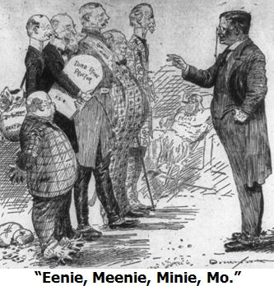
State Executive Branch
Prepares the Budget
Appoints cabinet members

Slide 10



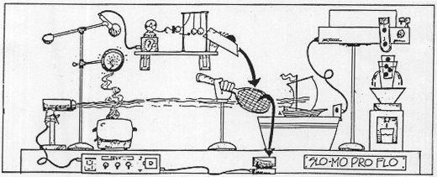
State Executive Branch
Grants pardons
Administers Bureaucracy

Slide 11



Governor’s Chief Jobs
Chief of State | Leader of the State
Chief Legislator | Proposes & Signs Laws
Chief Administrator | Makes sure Va. is working
Party Chief | Head of his political party
Commander-in-chief | Head of the Va. Nat’l Guard

Slide 12
Comic Life
Create a comic that:
  explains the jobs of the State Legislative Branch (general assembly) and the State Executive branch (governor)
  Your pictures must relate to the government job you are explaining

