Slide 1
Obey the Law
Pay Taxes
Civic Duties
(Mandatory)
Serve on a Jury
Serve in Military

Slide 2


Fulfill your civic duties
government
Protect your freedom and rights
citizens

Slide 3
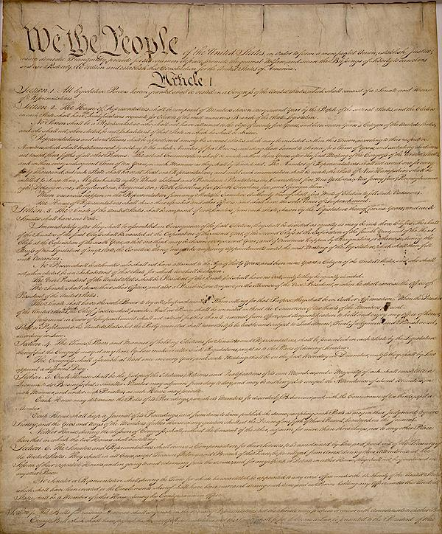
14th amendment
Defines citizenship
-birth
-naturalization
14 ^{th} amendment

Slide 4
Civic Duties
(Mandatory)
is this enough?
government
Obey the Law
Protect us
Pay Taxes
Jury
Military
citizens
citizens

Slide 5
Civic Duties
(Mandatory)
Civic Responsibilities
(Voluntary)
Obey the Law
Pay Taxes
Jury
Military

Slide 6



Civic Duties
(Mandatory)
good
enough
Civic Responsibilities
(Voluntary)

Slide 7

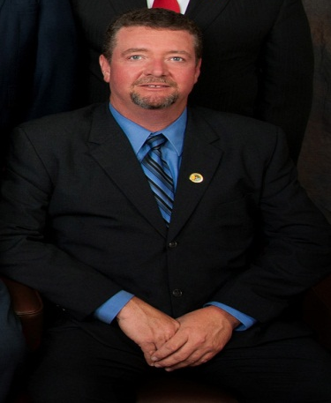
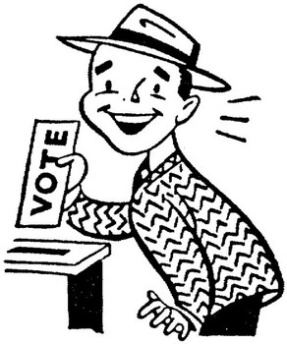
Civic Duties
(Mandatory)
Civic Responsibilities
(Voluntary)
Obey the Law
Register to Vote
and Vote
Volunteer
Pay Taxes
Hold Elective office
Stay Informed
Jury
Communicate with Gov’t officials
Respect others
Military
Participate in Political Campaigns
Respect others in the Gov’t

Slide 8


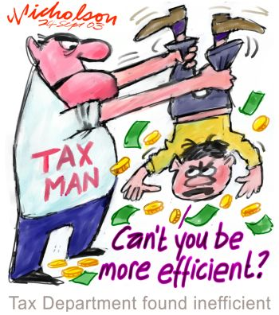
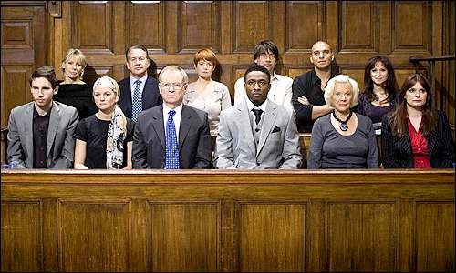
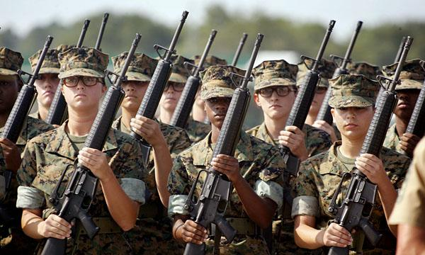
u1
birth
citizenship
14th
amendment
naturalization
Duties (mandatory)
Responsibilities (voluntary)
Obey the law
Pay Taxes
Serve in Military (if called)
Serve if Jury (if called)
Register to Vote and Vote
Hold elective office
Communicate with gov't officials
Volunteer
Participate in Political Campaigns
Read about current issues & stay informed
Respect others rights to and an equal voice in the gov't
Respect different opinions

