Slide 1
Electoral College

Slide 2
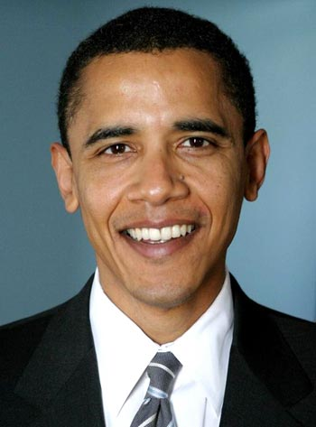
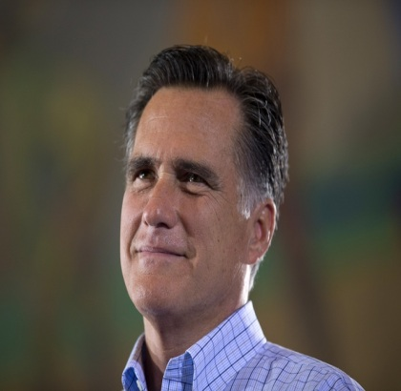


vs.

Slide 3
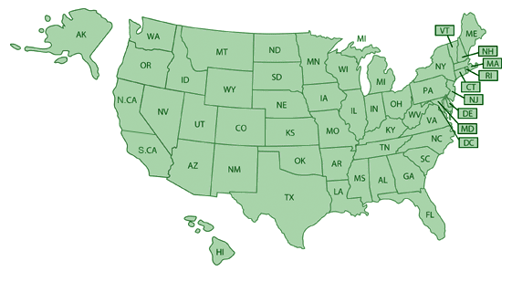
Popular Vote (total US votes)
2000 Election
Al Gore – 50,999,897
George Bush – 50,456,002
48.4%
>
47.9%

Slide 4
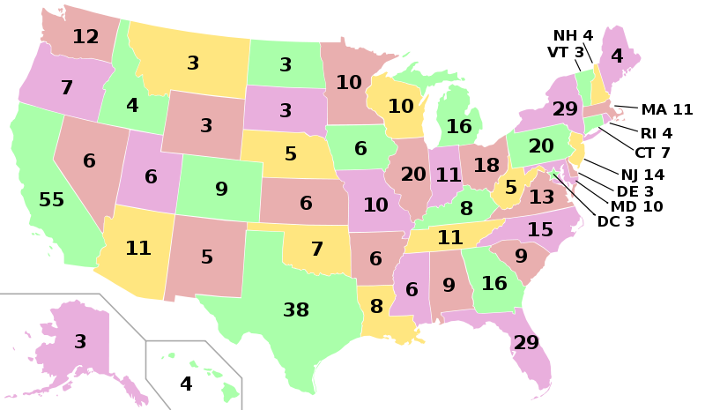
Romney gets all
38 electoral votes
Winner-Take-All
Obama gets
zero electoral votes
Johnson gets zero
2012 Election
Obama – 41%
(3.5 million)
Romney – 57%
(4.5 million)
Johnson – 1%
(800,000)

Slide 5
Hypothetical
Romney – 22
Obama – 15
Johnson – 1
NON-Winner-Take-All
2012 Election
Obama – 41%
Romney – 57%
Johnson – 1%

Slide 6
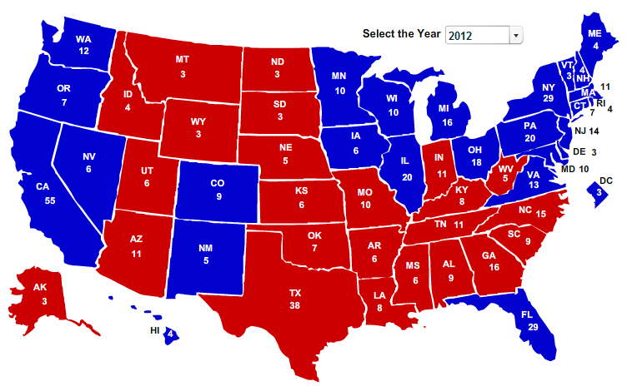

Slide 7
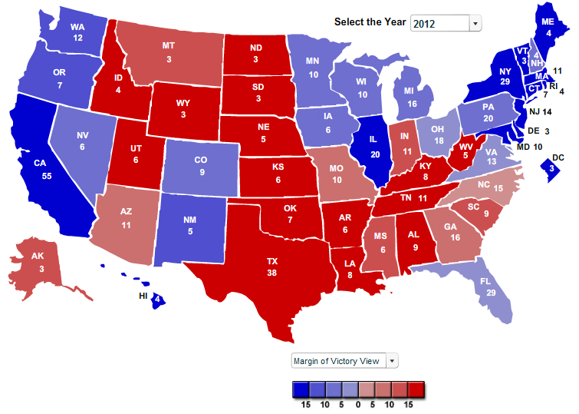
Winner-Take-All

Slide 8


Slide 9
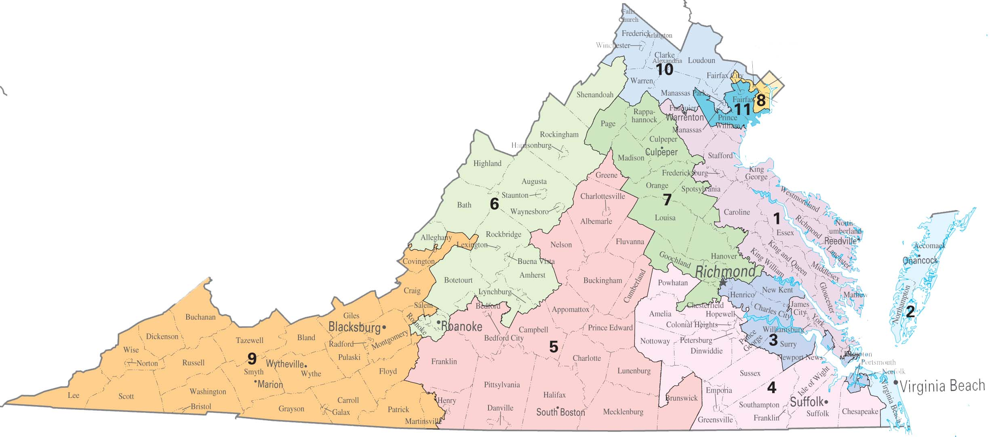

What else is based on population?
13
senators

Slide 10
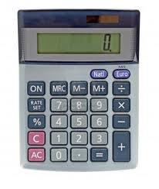
Majority Rule
538
269
2
538 points total
270 points wins
1 more than half is the majority

Slide 11
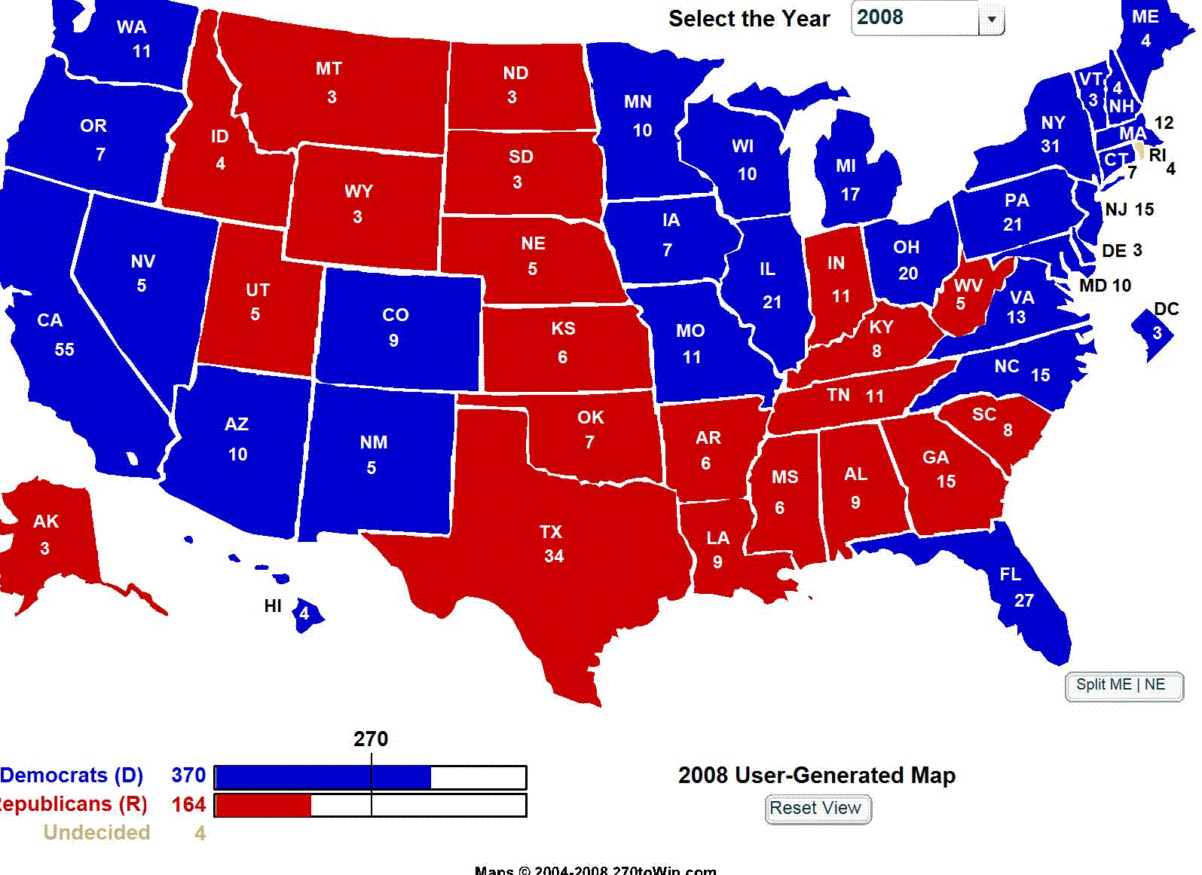

Slide 12
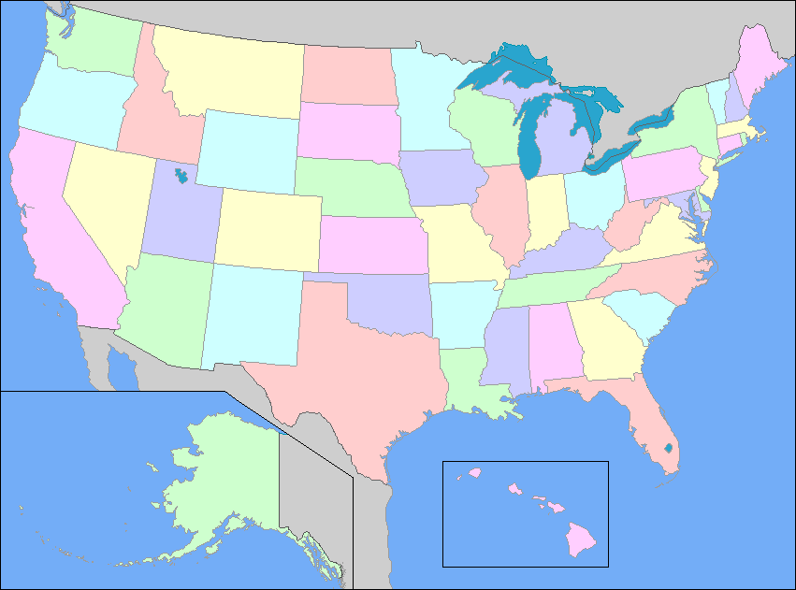

Educating Voters and Making Promises
?
?
?
?
Presidents would work for city people

Slide 13
