Slide 1



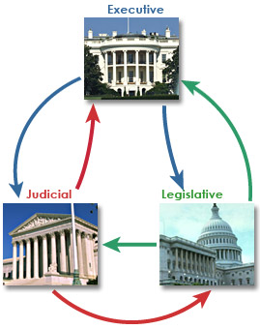
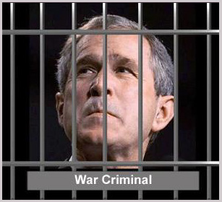
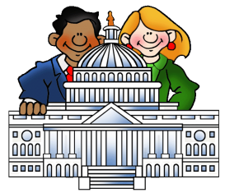

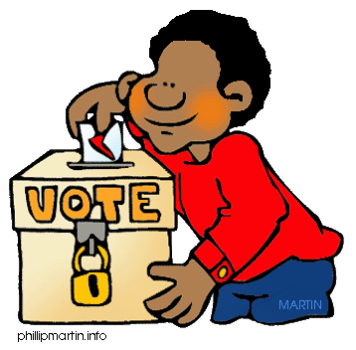
Fundamental Political Principles
Consent of the Governed
Consent of the Governed
Representative
Government
Representative
Government
Limited Government
Rule of Law
We pick people to vote for us
People are
The source of power
Democracy
Democracy
Gov’t cannot do anything it wants
No one is above the law
People rule thru voting

Slide 2
Fundamental Political Principles
Va Statute for Religious Freedom
Va Declaration of Rights
Charter of Va co of London
Declaration of Independence
Articles of Confederation
US
Constitution

Slide 3
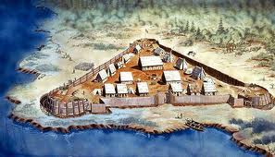
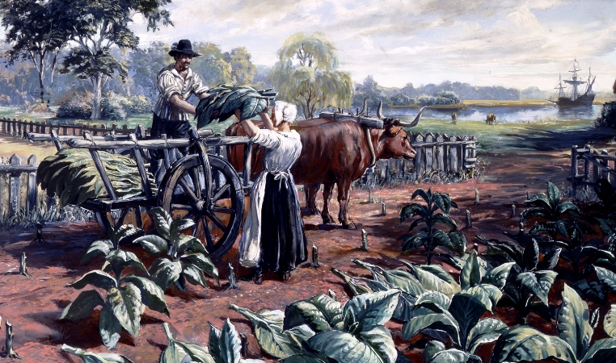
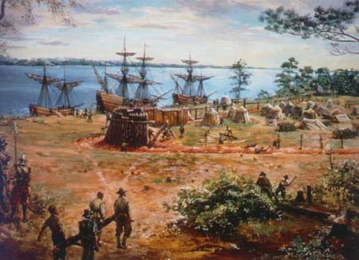
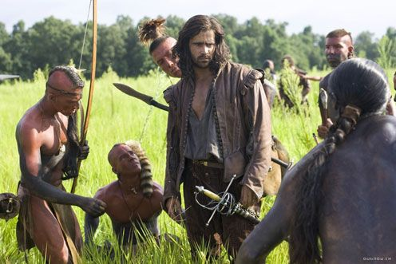
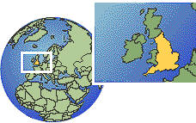
Jamestown (1607)
Charter of Va co. of London

Slide 4
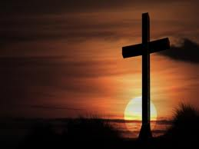


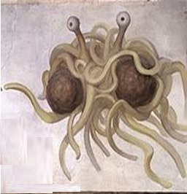
Va Statute for Religious Freedom

Slide 5




Va Declaration of Rights
US
Constitution
1st 10 amendments

Slide 6

Why does the Gov’t exist
England
USA
To make the King rich
To make the Rich richer
To make the King more powerful
Protect citizens:
  Life
  Liberty
  Property
Va Declaration of Rights

