Slide 1
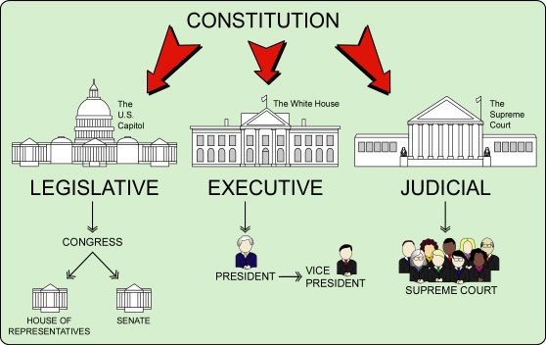

Slide 3
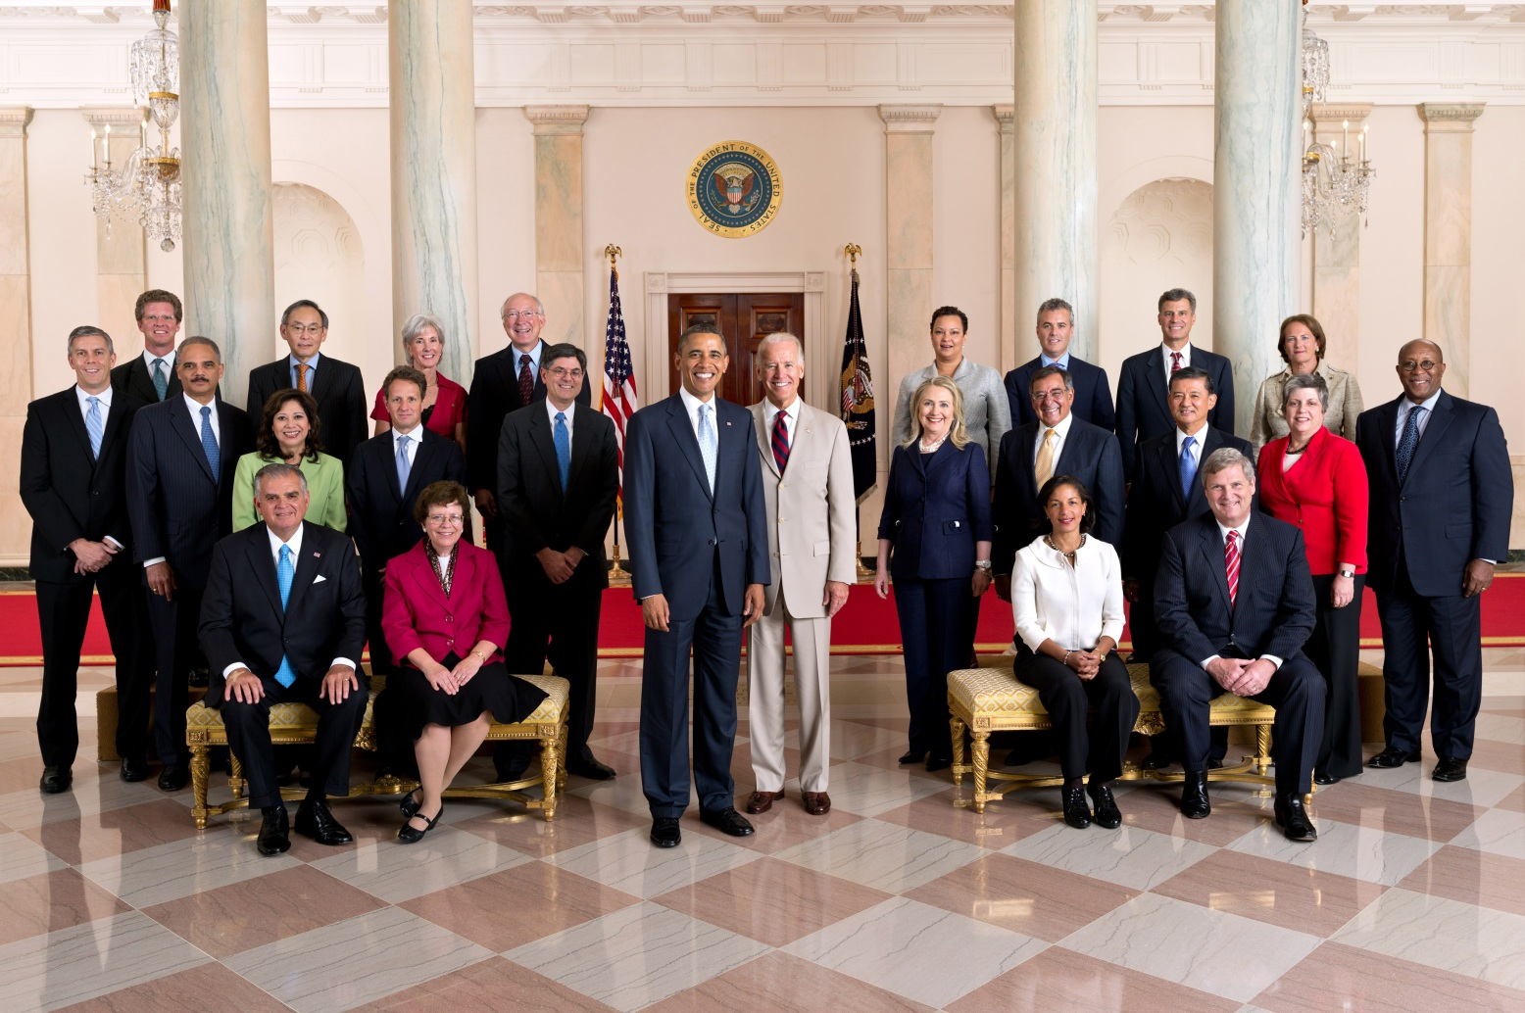
Executive Branch
President
Vice President

Slide 4
Executive Branch
Cabinet

Slide 5
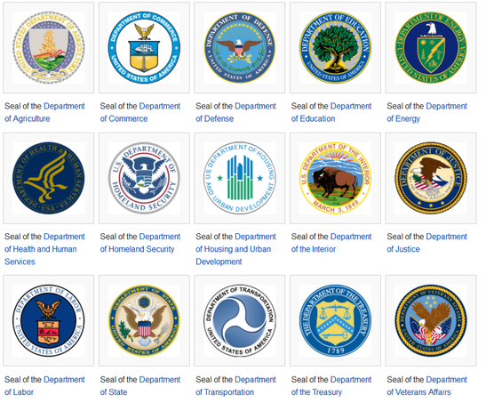
The President’s Cabinet

Slide 6
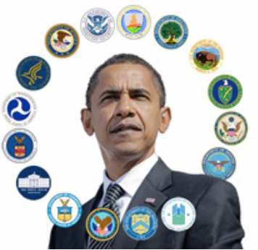
President Obama has 15 Cabinet Departments
Established in Article II, Section 2 of the Constitution, the Cabinet's role is to advise the President on any subject he may require relating to the duties of each member's respective office.

Slide 7
Executive Branch
Cabinet
Education
Defense
Treasury
quitting
quitting
Transportation
State

Slide 8
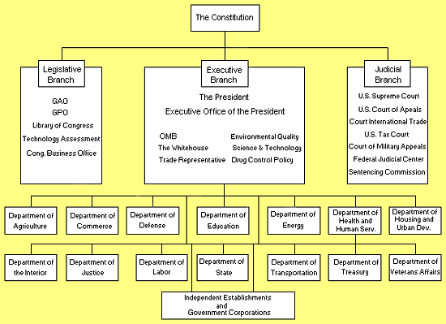

Slide 9
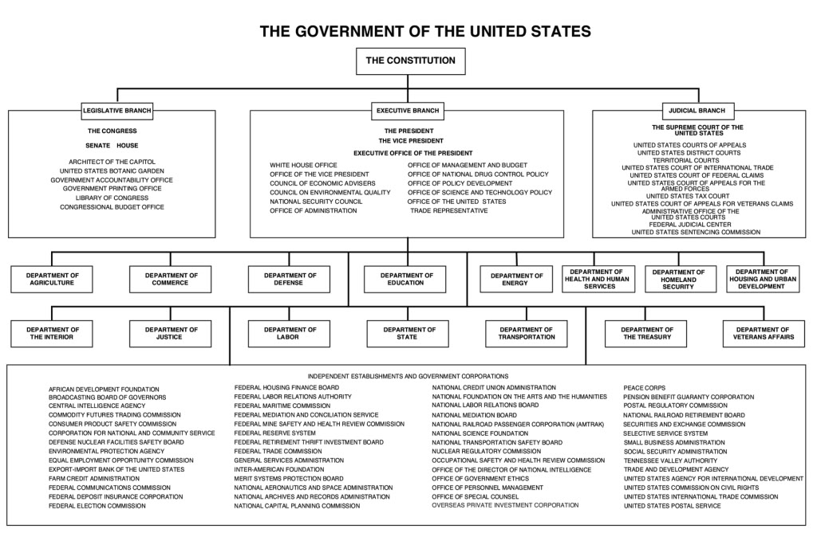

Slide 10


Understanding Policy….Think of a theft policy at different stores
Store #1
Store #2
Policy towards theft = Lenient
Policy towards theft = Harsh

Slide 11

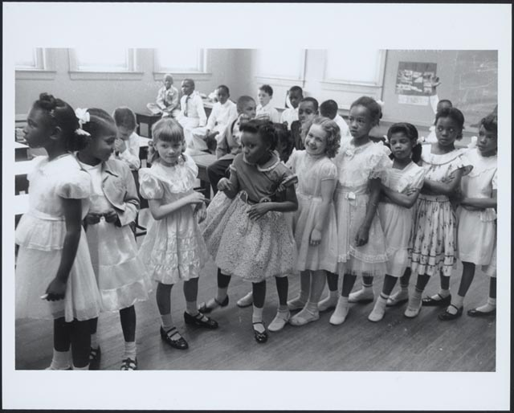
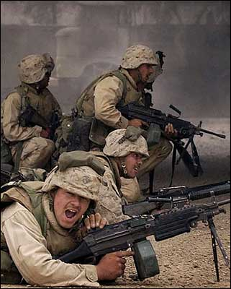
Democratic
Republican
Taxes
Taxes

Slide 12
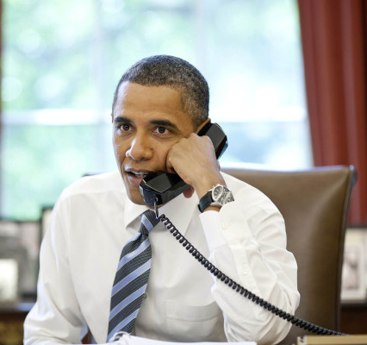
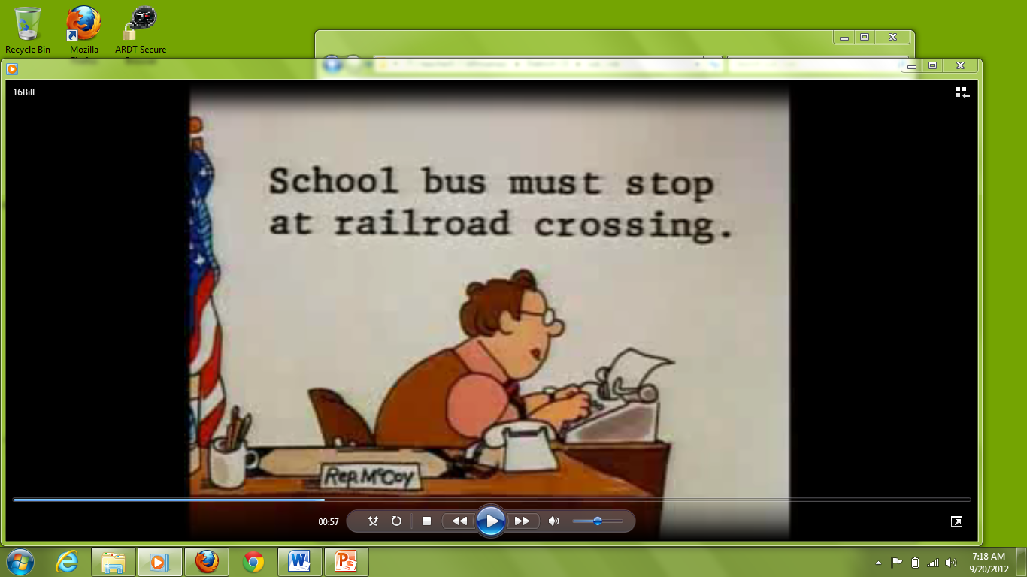
Hey congressman,
I need you to write a law about railroad crossings
Executive
Legislative

Slide 13
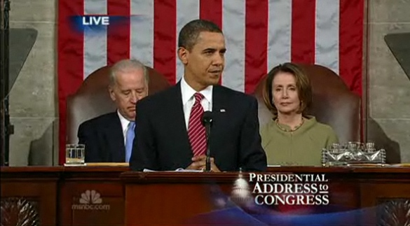
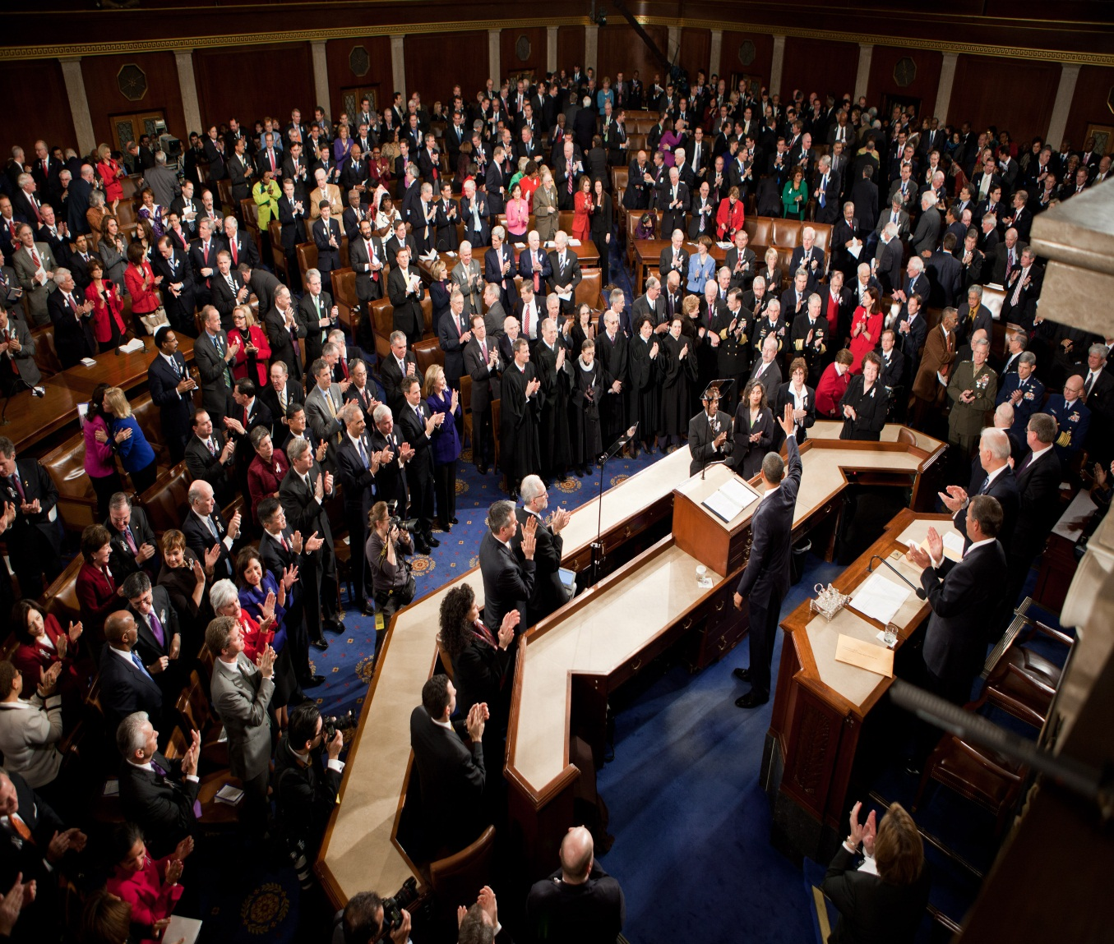
State of the Union address
I want a law that raises minimum wage to $9 an hour.

Slide 14
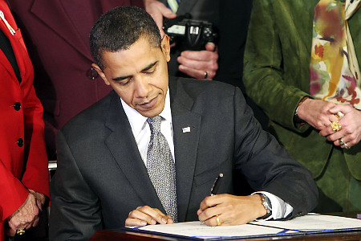

Slide 15
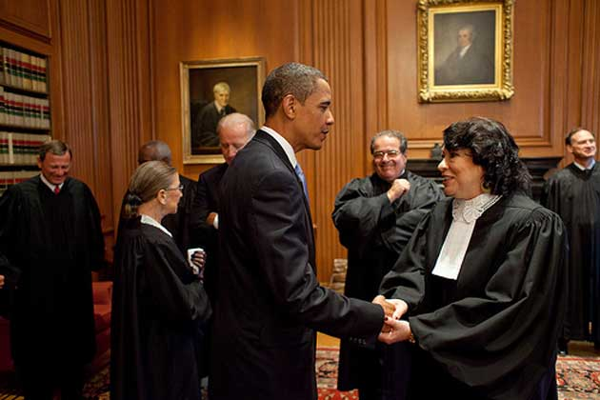
Appoints… Judges and Important Government Officials

Slide 16

Executive
Legislative
L
US Budget
Income | 2.5 trillion
Military | -900 billion
Social Security | -730 billion
Medicare | -500 billion
Medicaid | -300 billion
Gov’t Costs | -500 billion
Other | -600 billion
Total | -1.27 trillion

Slide 18
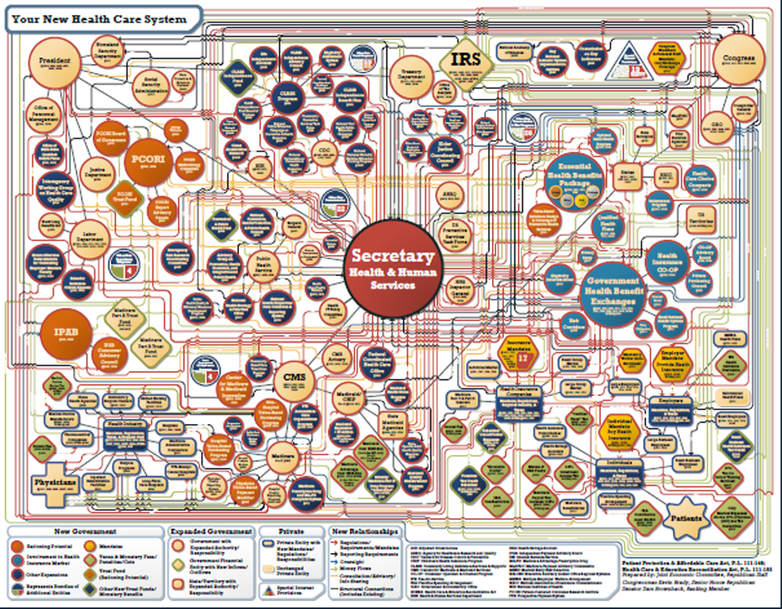

Slide 19

Understanding Bureaucracy
What all must happen for
a field trip to take place

Slide 20



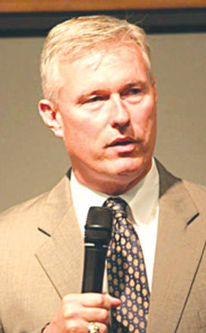
Understanding Bureaucracy
teacher
Head of
Math Dept.
Principal
superintendent
accounting

Slide 21

Understanding Bureaucracy
accounting
teacher

