Slide 1
Express Concerns
Part 1
Life could be better in Virginia, but you need to let your government officials know what requires their attention.
  In Microsoft word, write a brief description (5-7 sentences) about an issue that needs our government’s attention.
  Proof read your paragraph and look for mistakes.
  Copy your text.
  Go to the following page:
    If for the City of Richmond Government
    http://eservices.ci.richmond.va.us/applications/RichmondGovContactUs/ContactUs.aspx?ID=25
    If for the Virginia Government
  Paste the text in the message box
 | http://DelJMcClellan@house.virginia.gov

Slide 2
Volunteer
Part 2
You will make one PowerPoint slide
Treat this slide like a Billboard
The objective of your slide is to convince people to volunteer in a specific way
  Be creative
  Make sure your slide is legible
  Must be original
    you may copy pictures but not text
We will display all of the slides on the board and vote on the best slide

Slide 3
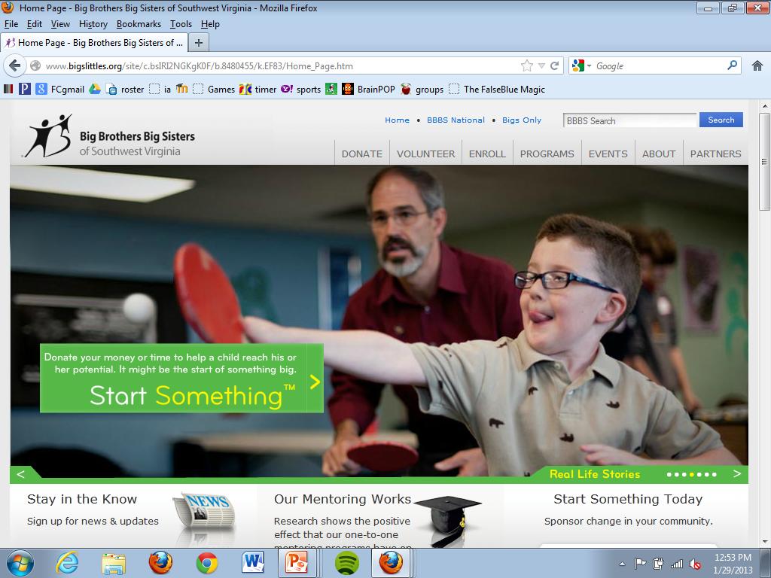
83% of littles agree that their Big instilled values and principles that have guided them through life.
Join!!!
Big Brothers Big Sisters
of Southwest Virginia
Help children
realize their
potential
www.bigslittles.org

Slide 4
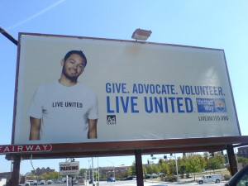

Slide 5


Slide 6


