Slide 1
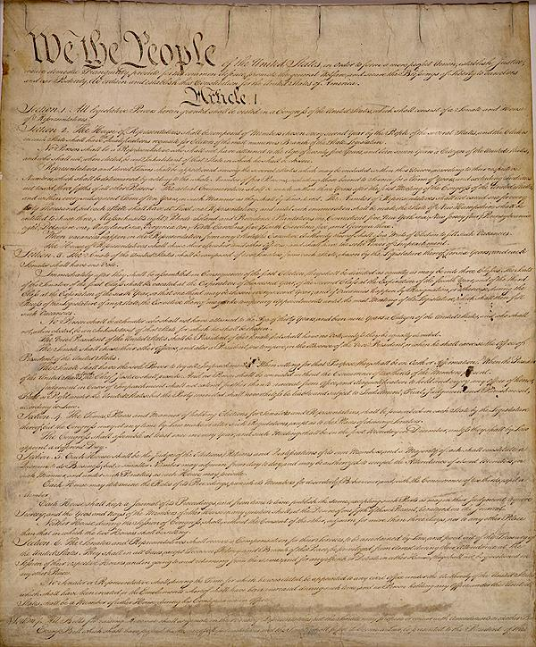

Slide 2
Preamble
We the people of the United States, in order to form a more perfect union, establish justice, insure domestic tranquility, provide for the common defense, promote the general welfare, and secure the blessings of liberty to ourselves and our posterity, do ordain and establish this Constitution for the United States of America.

Slide 3



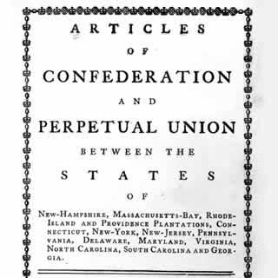


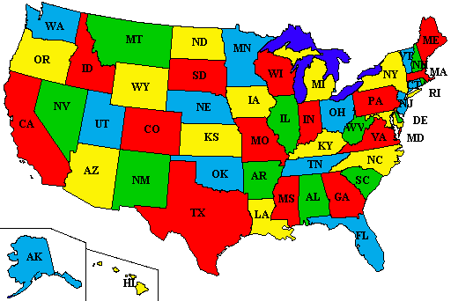

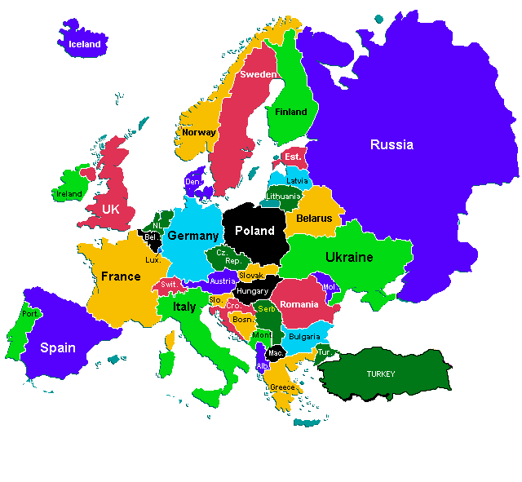

Preamble: intro that states the purpose of the US gov’t
We the people
To form a more perfect union
establish justice
domestic tranquility
common defense
promote the general welfare
blessings of liberty
Consent of the Governed
Kill Articles of Confederation
Fair courts & laws
Peace in USA
Protect from other countries
Make our lives better
Protect our rights

