Slide 1
Media

Slide 2
Power Point Notes/Quiz
Listen to the notes and…
  answer the following questions
Answer:
Who is the media?
What does the media do?
  What specific ways does the media do this?
How does the Media affect Public Policy

Slide 3

1. Who is media?
2. What does media do?
3. Specific Ways?
4. Media & Public Policy?

Slide 4

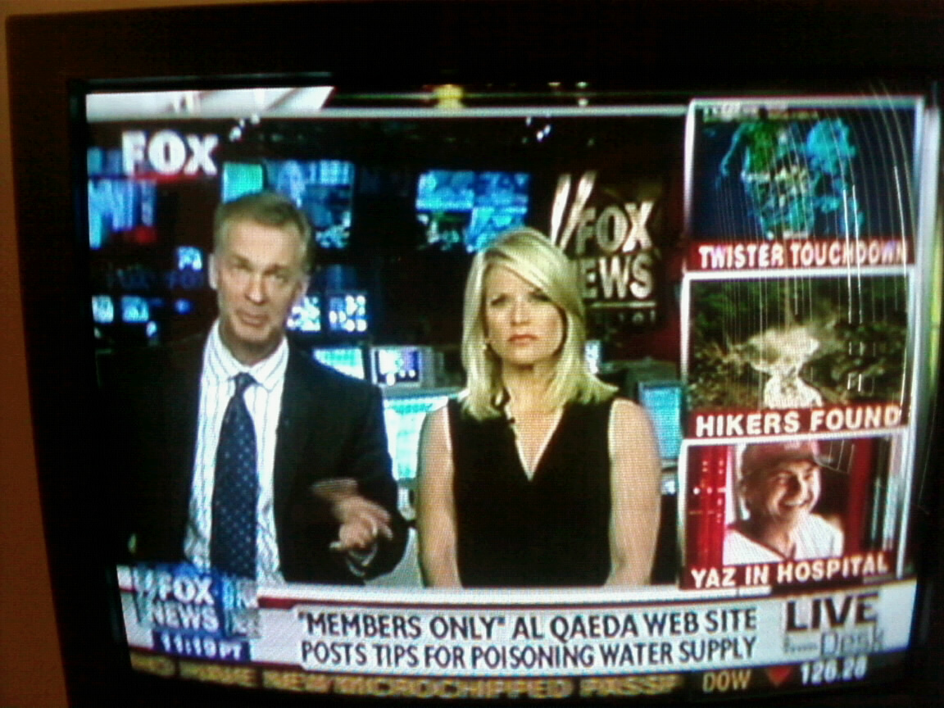
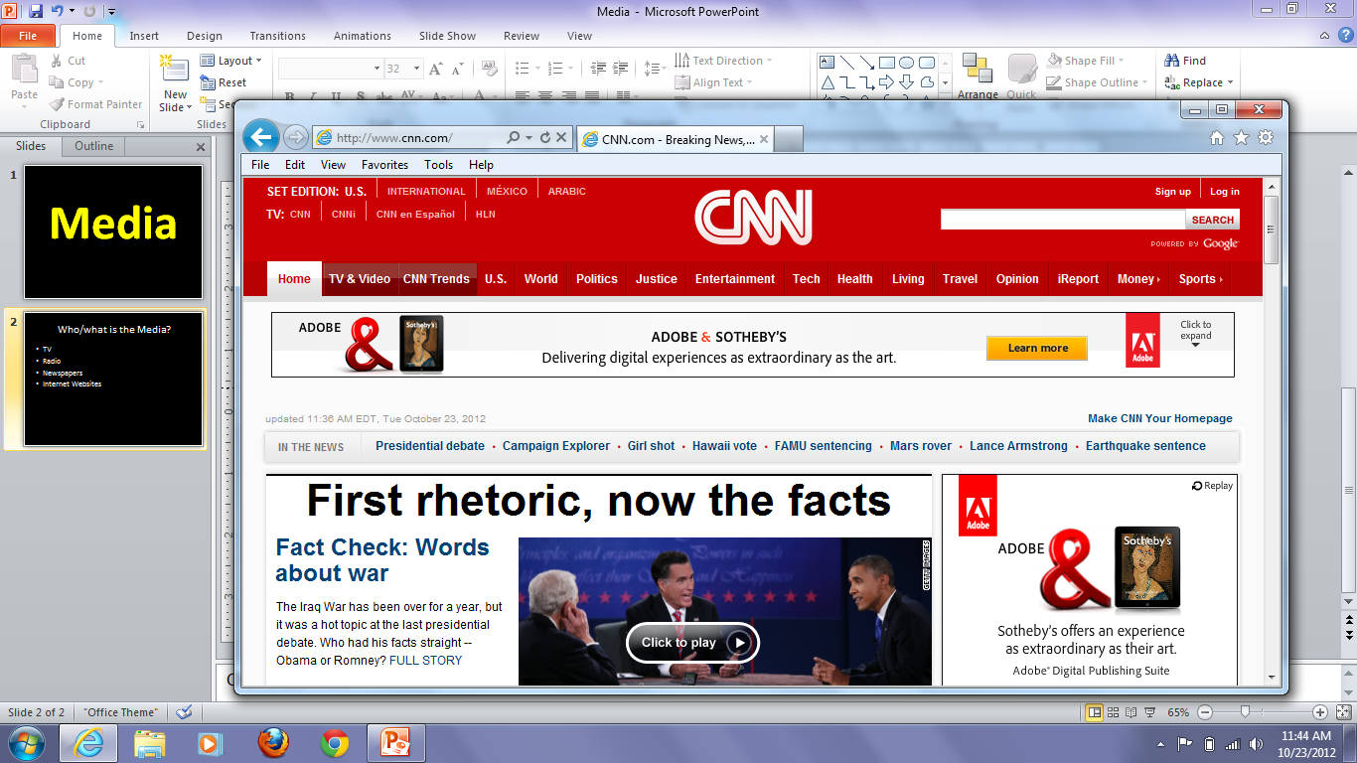
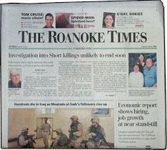

Who/what is the Media?
Who?
What?
Specific ways?
Policy?
TV
Radio
Newspapers
Internet Websites

Slide 5
Media
Who?
What?
Specific ways?
Policy?
Who?
TV
Radio
Newspaper
Websites
What
do they
Do?

Slide 6
Media
Who?
What?
Specific ways?
Policy?
Who?
TV
Radio
Newspaper
Websites
What?
Keep citizens
informed

Slide 7
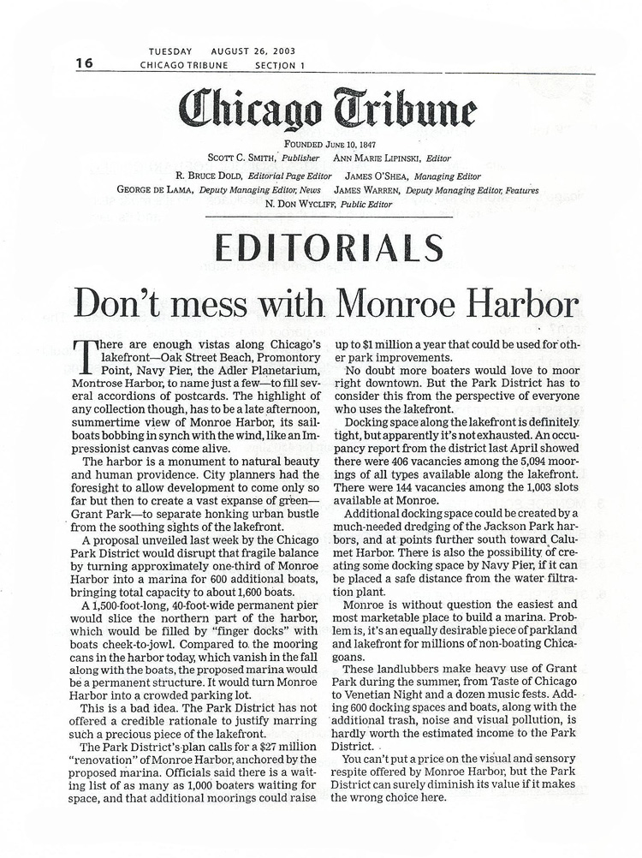


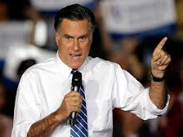
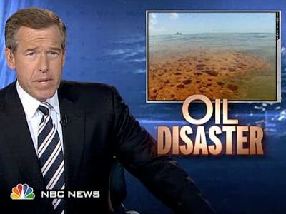
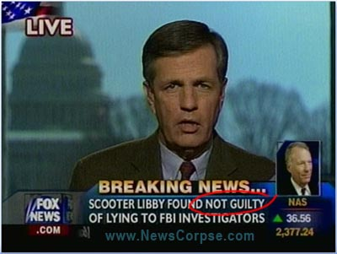
What does the media do?
Who?
What?
Specific ways?
Policy?
Keep Citizens informed
  Identify Candidates
  Emphasize issues
  Write editorials
Why is it
Important to keep
citizens informed?
Citizens choose
the leaders of our
Government.
I am running for president!

Slide 8
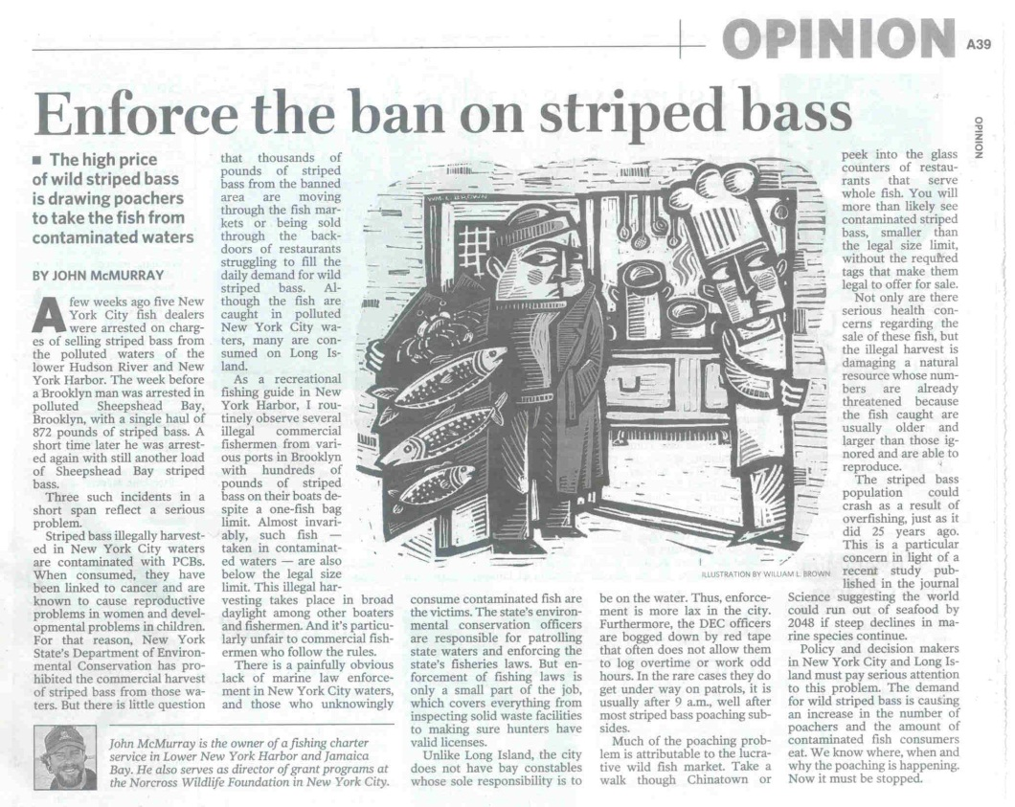
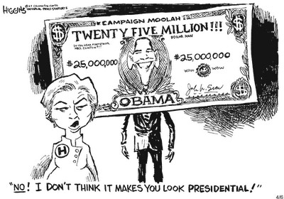
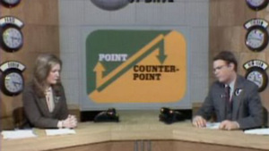
What does the media do?
Who?
What?
Specific ways?
Policy?
Keep Citizens informed
  Create Political Cartoons
  Publish op-ed pieces
  Broadcast different points of view

Slide 9
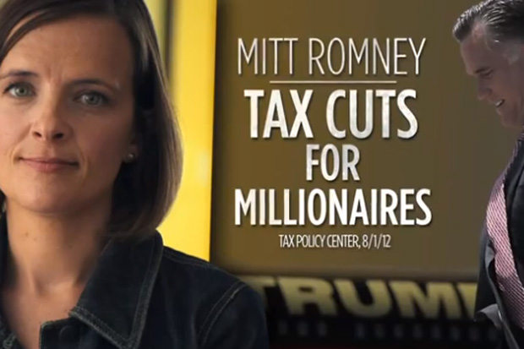
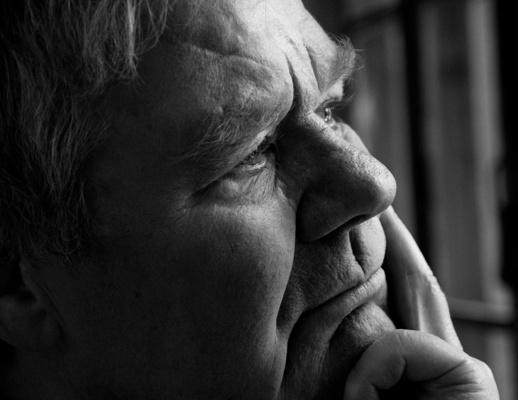
Political Campaign confusing?
Who?
What?
Specific ways?
Policy?
The Media
can help

Slide 10
Political Campaign confusing?
Who?
What?
Specific ways?
Policy?
TV ad
against
Romney
False!!!

Slide 11
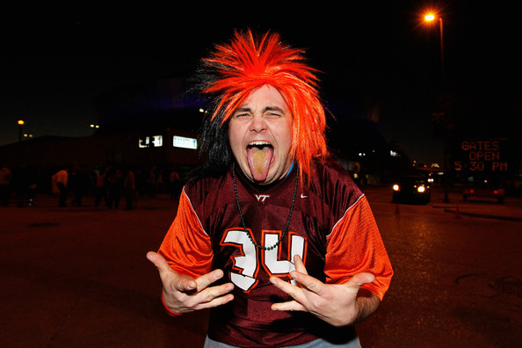
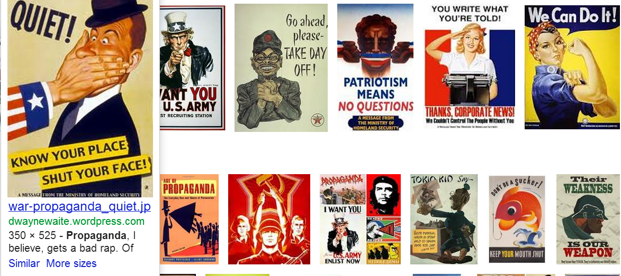



Media helps us understand campaigns
Separating fact from fiction
Detecting Bias
Evaluating Sources
Identify Propaganda
v
v
TV ad
against
Romney
False!!!
BIASED

Slide 12
Let’s watch some political ads!!!
TV ad
against
Romney
False!!!

Slide 13


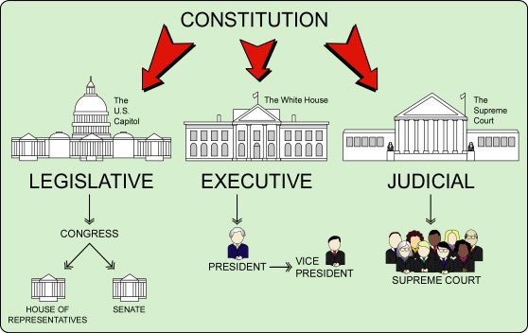
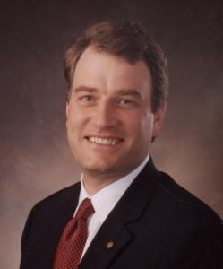
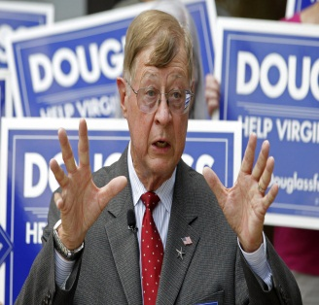
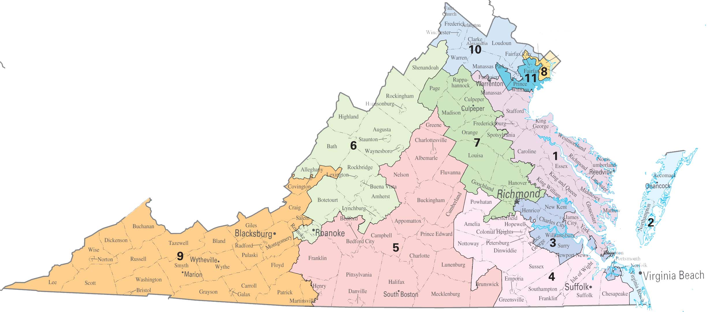

Scott
Nobody

Slide 14
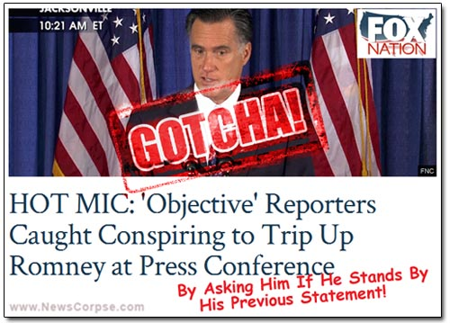
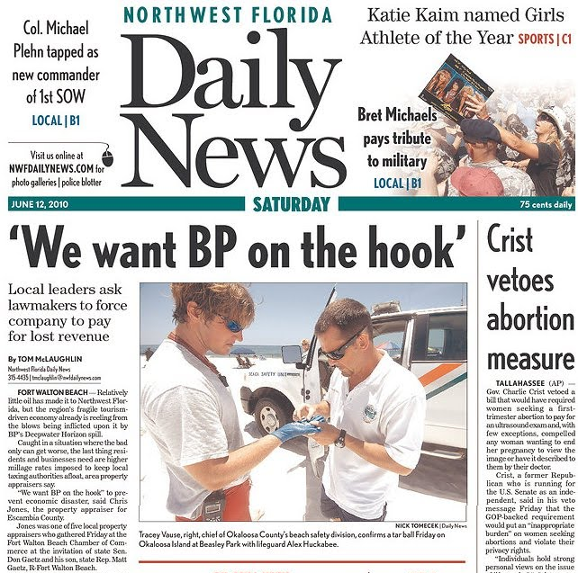
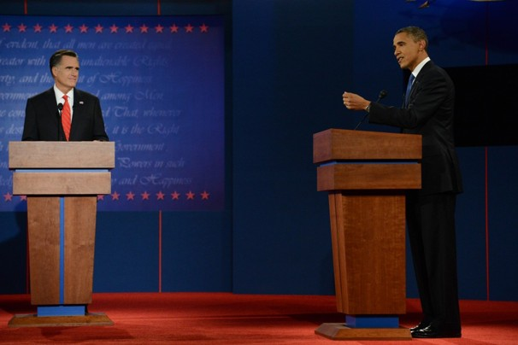
Media and Public Policy
Who?
What?
Specific ways?
Policy?
Public Policy: The Plan for our government
Media will:
  focus on selected issues
  offer a forum
    Televised Debate
  Hold Government accountable
    Call them out when they do wrong

Slide 15
Media Search
Find it, then explain it
  Political Cartoon
  Newspaper Editorial about “Guns”
  Newspaper Op-Ed on “Iraq war”
  News site emphasizing an issue
    DO NOT LITERALLY SEARCH “emphasizing an issue”

