Slide 1
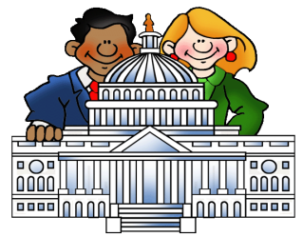


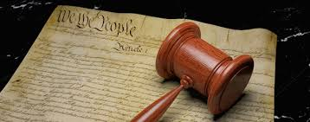
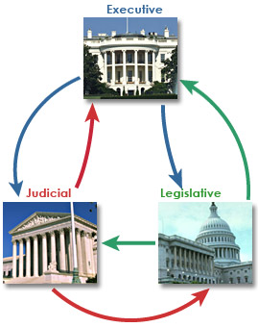



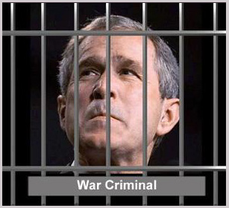
u2
Fundamental Political Principles
Consent of the Governed
Representative
Government
Limited Government
Rule of Law
We pick people to vote for us
People are
The source of power
Democracy
Gov’t cannot do anything it wants
No one is above the law
People rule thru voting

Slide 2
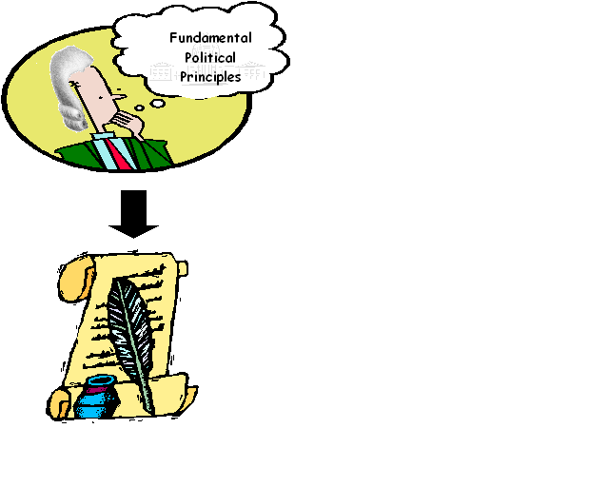
u2
Significant Documents
Charter of the Va. Company of London
Article of
Confederation
Virginia Statute of Religious Freedom
Declaration of
Independence
Virginia Declaration of Rights
-Rights of
Englishman
-1st rep. gov’t
-Believe in
what you
want
-Life, liberty,
Property
-model for
Bill of Rights
& Dec of Indy
-grievances
-independence
-equality
-life, liberty,
Pursuit of
happiness
-1st nat’l gov’t
-weak central
-strong states
-No: Prez, Taxes
Currency,
Enforce laws
-Life, liberty,
Property
-model for
Bill of Rights
& Dec of Indy
-grievances
-independence
-equality
-life, liberty,
Pursuit of
happiness

Slide 3


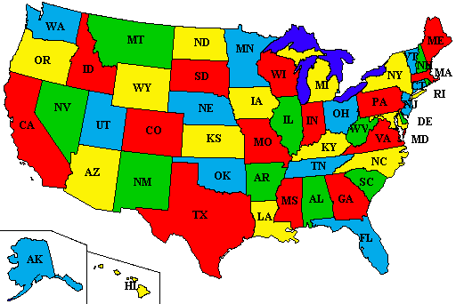
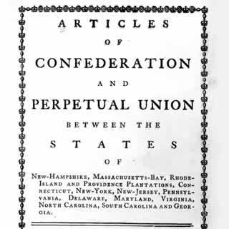





Preamble: intro that states the purpose of the US gov’t
u2
We the people
To form a more perfect union
establish justice
domestic tranquility
common defense
promote the general welfare
blessings of liberty
Consent of the Governed
Kill Articles of Confederation
Fair courts & laws
Peace in USA
Protect from other countries
Make our lives better
Protect our rights

Slide 4
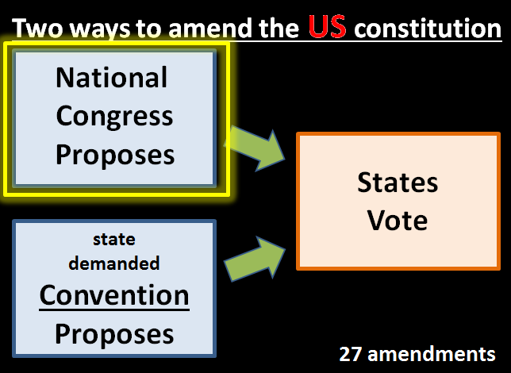
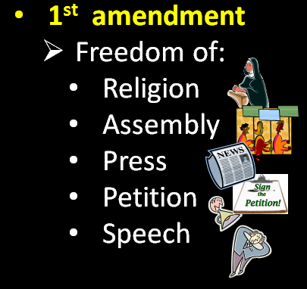
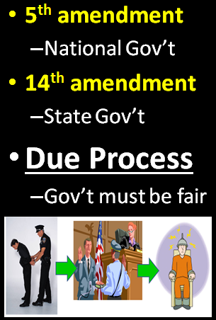
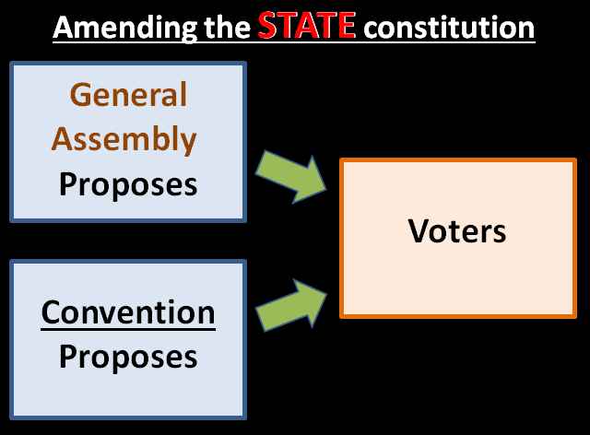
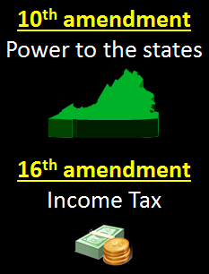
u2

