Slide 1
Civic Duties Collage
On the next slide find 4 pictures for each of the civic duties (16 total)
  Copy and past the pictures to the slide
On the final slide write a short story (one paragraph) about a time that you fulfilled a civic duty

Slide 2
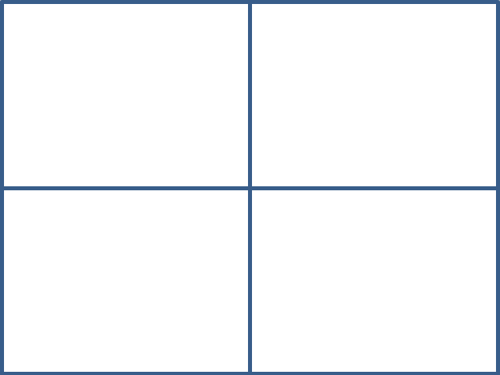

Slide 3
Civic Duty Story

