Slide 1
News Media and Politics Reading
Unit 4

Slide 2
For this unit, when we discuss the Media, we do so in terms of Politics. The big question that we must answer is, “How is the media involved in Politics?” The News Media (TV, radio, Newspapers, Internet Websites, etc.) helps citizens understand current political events. This is an incredibly important task because the United States is a democracy; the people of this county make the decision, so it is important that we are informed.
Question 1:
What is the news Media’s main job?

Slide 3
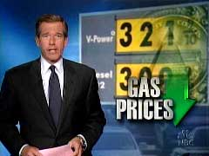
The News Media keeps citizens informed by reporting the news. There are many important issues and problems in America that need to be solved. The media informs citizens about these issues, and then citizens vote for government leaders that can solve these issues.
Another important task of the media is identifying candidates. The Media helps citizens find out about the politicians campaigning for a government position. This helps citizens select the best candidate.
Question 2: What are the two ways that the media helps citizens make better choices when voting?

Slide 4
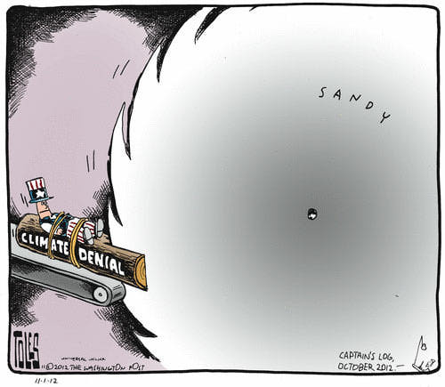
Political Cartoons created by newspapers are an effective tool in educating citizens for a couple of reasons. First, they are often funny and memorable. Secondly, they require citizens to think and analyze as opposed to just simply reading the words on the page.
Question 3: Explain the Political Cartoon.

Slide 5
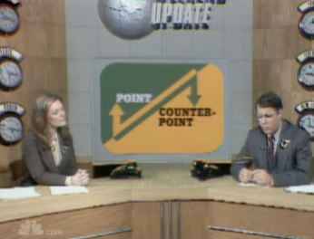
The Media’s role is to report the news. They must do so in a fair manner. One method for reporting the news in a fair manner is to report different points of view or both sides of a story. When violent events occur in the United States, many citizens blame guns; other citizens blame gun owners. The media must broadcast (or show) both sides of the issue. The Media is not supposed to give their opinion, they simply report the news to keep us informed.
Question 4: What method does the media use so that it reports the news fairly?

Slide 6
There are exceptions to every rule. Media members are citizens, well informed citizens, and they do have the right as a citizen to give their opinion. An editorial, is an opinionated article or report that attempts to inform citizens on an issue. Ninety-five percent of a daily newspaper is an example of the media reporting the news. However, on one page (the editorial page), the media informs citizens by giving their expert opinion.
Question 5: Do you think it is acceptable for media members to give their opinion? Why or why not?

Slide 7
On the newspaper page right next to the Editorial page is the Op-Ed page (opposite editorial). On this page, the media allows citizens to write their own opinionated letters. If a citizen is upset about an issue and wants to informs citizens, then he or she can write a letter to a newspaper. If the letter is appropriate and decently written, then the newspaper will print it on the op-ed page in order to inform citizens.
Question 6: What is the name of an opinionated letter written by a regular citizen?

Slide 8
POLITICAL CAMPAIGNS
We have all seen TV ads and posters paid for by democrats and republicans. They often make some pretty strong claims. For example, republicans accused Barack Obama of not being a citizen, while democrats accused Mitt Romney of not paying his fair share of taxes. How can a citizen find out the truth? Another role of the media is to help citizens understand political campaigns.
Question 7: Who helps citizens understand political campaigns?

Slide 9
POLITICAL CAMPAIGNS
The media investigates and researches the statements that politicians make when campaigning. The news media separates fact from fiction. In other words, reporters investigate the statements of politicians and let citizens know if they are telling the truth.
One of the best ways to get to the truth is to evaluate sources. If a politician makes a statement, they have to explain where they got their information. The Media, like an English Teacher, double-checks the source to make sure the politician is not stretching the truth.
Question 8: What is the media more similar to:
a lie-Detector test or a detective. Explain your answer.

Slide 10
POLITICAL CAMPAIGNS
The media informs citizens of when a candidate is being biased. Bias means that a person shows favoritism, prejudice, or is being unfair. As human beings we are all biased in some ways. The Virginia Tech Hokies may have a great team, but some Virginians refuse to admit that because they simply hate the Hokies. This happens in politics as well. Politicians are biased towards all sorts of issues, and sometimes this gets in the way of a politicians job of representing the people. The media’s job is to let us know when this happens.
Question 9: What kind of political issue do you think politicians in Virginia show bias towards?

Slide 11
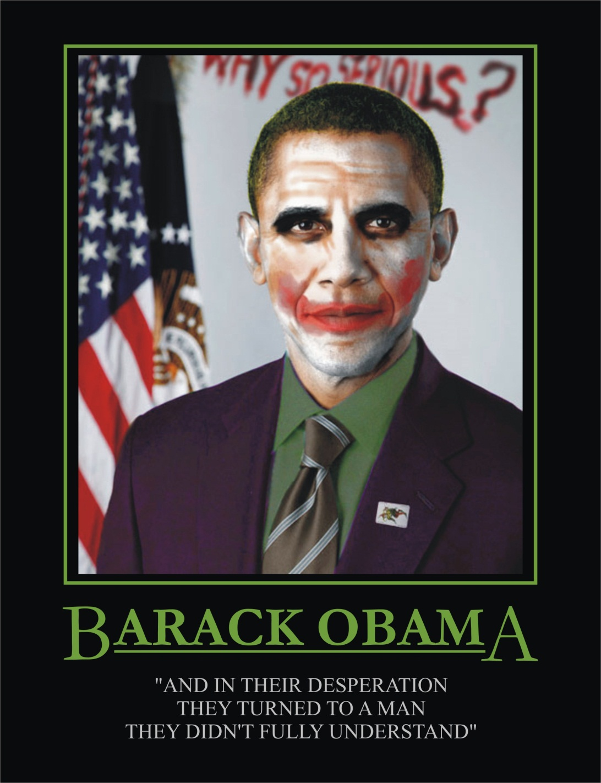
POLITICAL CAMPAIGNS
The picture to the right is propaganda. It is a form of communication that attempts to influence citizens by scaring them and often deceiving them. The medias job is to identify propaganda and inform citizens to ignore it.
Question10: What is the propaganda trying to say about Barack Obama?

